Slide 1
Why Document Accessibility?
Module 1

Slide 2
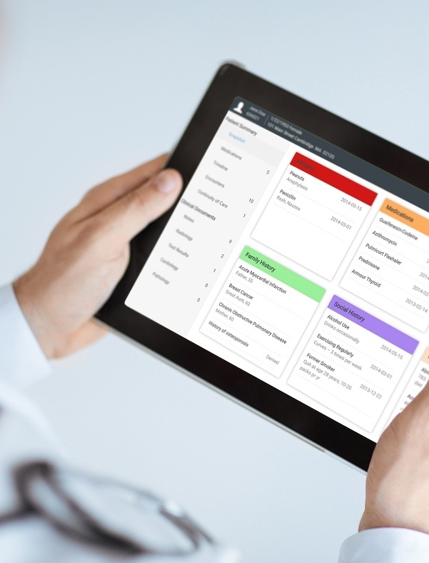
Crawford Technologies
CrawfordTech is a global software company focused on helping enterprises output, digitize and deliver customer communications
Our portfolio and know-how span the intersection of digital output, content management and analytics applications
“The work behind the workflow”
Accessibility
Content Services
Enterprise Output
Software and services provider for accessibility strategies and solutions
Optimizing content distribution strategy and
delivering high-value customer communication archive solutions
Transforming and optimizing workflows for all output processes

Slide 6
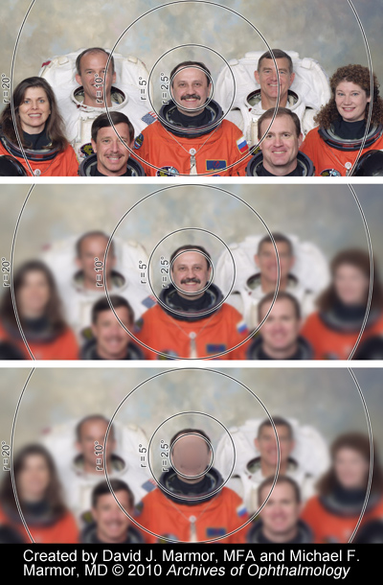
Through a camera
With full vision
With Macular Degeneration

Slide 7
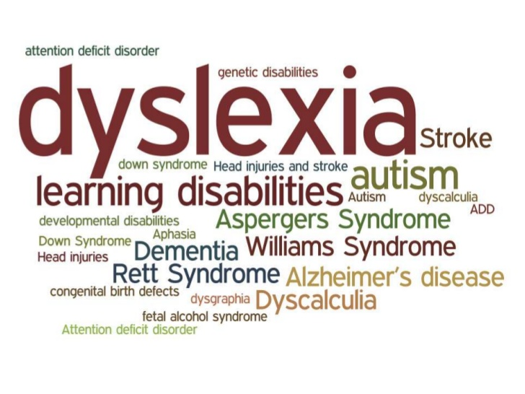

Slide 8
QUIZ
There are more people with ____?
Cognitive disabilities
Low vision or blindness
All of the above

Slide 9
Demographics
10% of adult Americans reported having trouble seeing
That 10% is roughly 21.2 million people
Even with corrective lenses, they still have trouble seeing
Notes:
Dennis

Slide 10
Demographics
30 million people in the EU are blind or partially sighted
More than 1 million Canadians are blind or partially sighted
Dyslexia affects 15% of North America
Notes:
Dennis

Slide 11
QUIZ
Blindness is a ______ ?
Continuum
Completely no vision
Obstructions
Low vision
All of the above

Slide 12
Future Projections
Blindness is expected to increase dramatically
Aging population is susceptible to macular degeneration or glaucoma
Diabetes diagnosis is increasing, a risk factor for eyesight loss
Notes:
Typically Alternate formats only represent 3-4% of all documents in an accommodation setting
More realistic numbers are 15-20%

Slide 13
What is required?
Reasonable Accommodations
Personal & Confidential
Web Access
Communications
Timely
Anti- Discriminatory

Slide 14
QUIZ: What’s Missing?
Personal & Confidential
Communications
Timely
Reasonable Accommodations
Web Access
Anti- Discriminatory

Slide 15
QUIZ
Is it ok for me to provide coupon offers at a kiosk which are not accessible?
Notes:
1) Harvard and MIT accessible exam and tests, (GMAT, LSAT and GRE tests)
2) Restricted time
DOJ litigation (ADA and Section 504)

Slide 16
Lifestyle
Diabetes
Macular Degeneration
Aging Population
Dramatic increase in partial vision loss and blindness

Slide 17
QUIZ
What is causing individuals to go blind ______ ?
Macular Degeneration
Diabetes
Living longer
All of the above

Slide 18
US Regulations
American Disabilities Act (ADA) - Anti-Discrimination Law
Section 508 RULE for doing business with the US GOV
Affordable Heath Care Act
Food and Drug Safety Innovation Act (904)
Telecom Act Section 255
Air Carrier Access Act Airline accessibility DOT rule Title 14 CFR Par 32
SEC – Rule 30 E3 - coming for Financial Reporting
20th Century IDEA Act (December 2018)

Slide 19
Canadian Regulations
Accessible Canada Act
AODA - Accessibilities for Ontarians with Disabilities
AMA - Accessibility for Manitobans Act
The Accessibility Act – Nova Scotia (2017)
Canadian Human Rights Act
Omnibus C78
Charter of Rights and Freedoms
Upcoming
British Columbia Accessibility Act, 2018 in Reading

Slide 20
Regulations
Note the highest regulations governs all laws
Generally most regulations are not prescriptive and do not tell you what to do.
Adhere to standards
ANTI- DISCRIMINATORY

Slide 21
Regulations
Doesn’t need to be 100% but has to be a good user experience
So far, no law suits for trying to implement accessibility despite poor attempts
That being said, consider user experience

Slide 22
Global Regulations
UK
Disability Discrimination Act - DDA
Special Educational Needs and Disability Act 2001 (SENDA)
EU
EU Charter of Fundamental Rights
EN 501-349 (similar to Section 508 ICT Refresh)
Mandate 376
Australia
ADDA - Australian Disability Discrimination Act 1992
France
Federal Ordinance on Barrier-Free Information Technology (English translation)
Projet de Loi Adopte Avec Modifications par le Senat
Germany
Web ohne Barrieren nach paragraph 11 (German)
Federal Ordinance on Barrier-Free Information Technology (English translation)
Ireland
Irish National Disability Authority IT Accessibility Guidelines (English)
Web Publication, Report of the Interdepartmental Group - Recommended Guidelines for Public Sector Organisations (English)
Italy
PubbliAccesso.gov.it (Italian)
Portugal
Accessibility of Public Administration Web Sites for Citizens with Special Needs (English)
Spain
Legislación Española sobre Accesibilidad para la Sociedad de la Información (Spanish)
Switzerland
Bundesgesetz über die Beseitigung von Benachteiligungen von Menschen mit Behinderungen (German, French and Italian)
This Photo by Unknown Author is licensed under CC BY-SA

Slide 23
Non-Compliance Is Costly
US Settlements in the millions of dollars have been levied against companies who do not comply with the relevant legislation

Slide 24
Legal Settlements / Fines - USA
State of Florida – Counties, municipalities
Winn Dixie – over $250K plus legal fees
Verizon - $20 million
Amex – structured settlement
Wells Fargo - $16 million
Target - $6 million
Harvard / MIT $2 million plus
Student Financing –
All Student loans must provide accessible documents
Elections
Hotels
Banks – NY Banks
Conduent – State of California – Parks and Recreation web site
Notes:
Photo by Sebastian Pichler on Unsplash

Slide 25
US - State Legislation / Vertical Legislation
State enacted legislation, litigated/settled
NY – Banks
CA – Intensive Section 508
Telecom – Section 255
Drug/Prescription – Section 904
Health – Affordable Healthcare Act
HHS Standard
Elections
Student Loans
Notes:
Photo by Sebastian Pichler on Unsplash

Slide 26
ADA Settlements
http://www.ada.gov/enforce_current.htm
http://www.adapacific.org/resources/lawsuits.php

Slide 27
Thank You
Notes:
1_title slide

