Slide 1
Selling Accessible Documents
Module 2
Notes:
1_Title Slide

Slide 2
Every Organization needs to consider Accessibility
Why Introduce Accessibility in your Conversations?
Right thing to do
Anti-discrimination
Compliance and penalty avoidance
Customer Satisfaction and keeping a client
Aging population

Slide 3
Accessibility Spectrum
Regulatory Compliance:
Making Websites and Documents Accessible to All
Full self-sufficiency – everything must be completed in-house
Will choose approach according to in-house skills and available offerings
Prefer to outsource as much as possible
Where do you fit along this spectrum?

Slide 4
Total Document Accessibility Platform
Accessibility Automation Software
Convert to WCAG, PDF/UA, HTML5, and all accessible formats
Deploy on premises or as SaaS
Outsourced Accessibility Services
Document remediation
Braille, Large Print, eText, Audio
Batch & post-archive retrieval
Convert from any print-ready file
Accessible document validation
Consulting services
Assessments and validation
Accessible WCAG, PDF/UA, HTML5
Training
Notes:
AccessibilityNow is a complete platform for creation of accessible documents. It has solutions to meet all document accessibility needs of all organizations, large and small, both private sector and governments of all levels worldwide. Our software solutions provide high levels of automation and integration into any environment and have solutions tailored to static documents of all types, and to transactional documents and their unique workflows. We provide a broad range of services including remediation of all document types and creation of all formats including Accessible PDF, Braille, Large Print, eText and audio. We provide fulfillment and mailing services as well as consulting services, training and assessments. We can come in and evaluate your documents for risk and provide you with a roadmap to compliance.

Slide 5
Total Document Accessibility Solutions
Transactional
Automatic tagging of high-volume transactional documents
Automatic tagging of all types of static documents
Fast, cost-effective, automated self-service document remediation
Designer for configuring transactional tagging rules
Connectors for ECM and Content Services platforms
Validate that documents are accessible
Scope website PDF accessibility state
Document remediation and QA services
Assess enterprise document accessibility needs
Dashboard for managing remediation projects and SLAs
Publisher
Designer
Gateway
Validator
SiteScan
Remediate
Assessment
Dashboard

Slide 6
Achieve Accessibility Goals
Comply with global regulations
Mitigate risk
Mitigate cost
Support all formats
Meet customers’ A11y needs
Over 1.3 billion people globally
Right format, channel
Improve CX
Timely and relevant
Automated
On demand
Transactional
Static

Slide 7
What is happening
Litigation and demand letters have grown 40% year over year

Slide 8
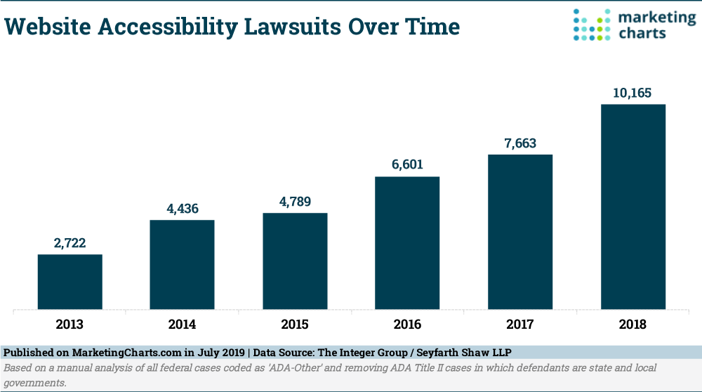
Notes:
This is a US based study.

Slide 9
Who are my Stakeholders?
Chief Compliance Officer down to Manager of Compliance
IT Manager – IT Accessibility
Output manager
Director of Customer Service
Billing Manager
Web Accessibility

Slide 10
Selling
Look at your existing business
Transaction
Compound documents
On-demand fulfillment
Documents on the web
Documents that are created in your office

Slide 11
Strategy
AccessibilityNow Publisher for Published documents
AccesssibilityNow.com for published documents that are ad hoc
AccessibilityNow Transactional for high volume systematically generated content
AccessibilityNow SiteScan & Validator for documents accessed via website
Alternate formats – braille, large print, eText and Audio

Slide 12
Ask: What is your Accessibility Strategy?
Discuss – accommodation versus compliance
Are you planning to make all documents accessible?
Is client services trained to respond to requests? Do you have a means to log requests
Are you considering short term and long term?
Do you want across the board compliance or only deal with accommodation requests
AODA will push demand - Canada
ADA and Section 508 ICT Refresh
Global laws – EU/UK

Slide 13
Focus on Regulatory Mandates For Accessible Documents
Each vertical now has specific legislation. Ask about what your clients are doing. If they are working with the US GOV… ask!
Health
Pharmacy
Banking
Telecom
Student Loans
Elections
Government
Wealth

Slide 14
Vertical Regulations
ADA – Title II, III
Health – Affordable Care Act
Food/Drug – Section 904 Food and Drug Safety Innovation Act
Telecom – Section 255 (part of ICT Refresh)
Section 504 – Education / funded
SEC – upcoming Section 30 e3
Banking – rulings
Student Loan – rulings
ADA – website litigation including documents

Slide 15
Key applications – Health - US
Affordable Health Care Act – Medicare/Medicaid
ANOC (Annual Notice of Change)
EOC (Evidence of Coverage)
Directories
SBs Statement of benefits
EOBs (Explanation of Benefits)
Patient release
Brochureware
Letter generation

Slide 16
Telecom
Statements and invoices
Contracts
CSA – Customer Service Agreements
WSA – Wireless Service Agreements
WCOC – Wireless Code of Conduct
Privacy Statements
Code of Conduct
Letters
Welcome kits

Slide 17
Pharmacy
Prescriptions
Drug information sheets
Drug prescription history
Drug Interaction information

Slide 18
Public Sector
All documents
All documents on a website
Public access to information
Pay / Pensions
Letter generation
Organizations doing business with the Federal government – Section 508 NPRM (US) and European Union (EN 301-549)
Archived documents

Slide 19
Insurance
Health
Property & Casualty
Life
Auto (yes even Auto)
Letter generation

Slide 20
Banks
Statements
Credit Card
Mortgage
Loans
Letter generation

Slide 21
Print Service Providers
Many are being asked by their banks, health, wealth, insurance and government providers to have accessibility
AccessibilityNow Transactional
Alternate formats
Accessible documents - tagging and remediation

Slide 22
What to Probe
Discuss AODA / ADA / Section 508 timelines
Look at transaction documents
Ask about number of requests for accommodation
Understand compliance vs accommodation

Slide 23
Discuss
Automating document accessibility production
Making paper accessible – Large Print
eDelivery & ePresentment - Accessible PDF

Slide 24
Your Clients
There are still certain organizations that do not know about AODA / ADA / Section 508 (few)
Many organizations are focused on web pages and ensuring compliance
Web & documents must be synchronized

Slide 25
CrawfordTech Strategy
Sell our solution as a one-stop strategy for document accessibility needs
AccessibilityNow Total Document Accessibility Platform
One Stop Accessibility Service Bureau
Accommodation
Static & Transactional
Remediation & Transcription
QA and QC
Consulting and Training

Slide 26
Selling against Composition
See whitepaper – email
Composition costs are high
Use of programmer versus a person who tags
Lack of testing
Updates in composition versions need files to be recompiled or adjusted
PDF “bloating”
Archive storage costs

Slide 27
Complexity Examples
Simple Document: Bank Statement – Level 1
Columns / Tables & Subsections: Wireless Statement – Level 2
Graphics, compound documents: Insurance Policy – Level 3

Slide 28
What are the objections
Cost of set up too high for small numbers
I can read it to the client - NOT
Needs to be WCAG 2.0 Level AA not PDF/UA
Electronic testing – user testing

Slide 29
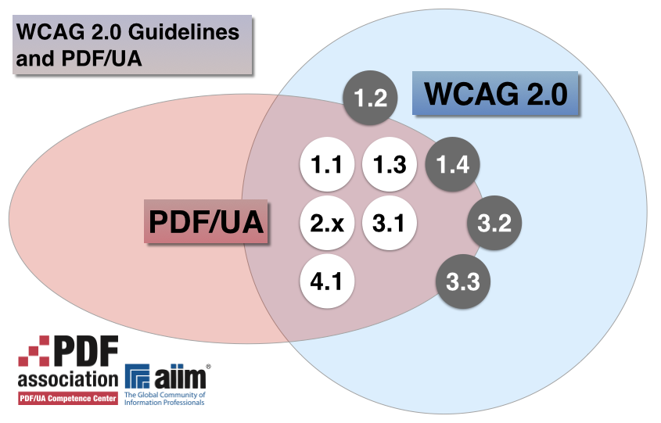
PDF/UA & WCAG
WCAG 2.0 Level AA
PDF/UA
Section 508 ICT Refresh

Slide 30
Handling objections
Discuss alternate format costs
Legal obligation
Timing for implementation?

Slide 31
Legality of Alternate Formats
Paper accommodation documents are not legal. Printed paper is legal
PDF or PDF Accessible is deemed legal

Slide 32
Resources
Samples
Presentation
Brochures and spotlights
Whitepapers
Web Content
Webinars – upcoming & prerecorded

Slide 33
Total Document Accessibility Solutions
Transactional
Automatic tagging of high-volume transactional documents
Automatic tagging of all types of static documents
Fast, cost-effective, automated self-service document remediation
Designer for configuring transactional tagging rules
Connectors for ECM and Content Services platforms
Validate that documents are accessible
Scope website PDF accessibility state
Document remediation and QA services
Assess enterprise document accessibility needs
Dashboard for managing remediation projects and SLAs
Publisher
Designer
Gateway
Validator
SiteScan
Remediate
Assessment
Dashboard

Slide 34
Additionally…
Call Crawford Technologies
Training – full accessibility training
Professional Services & Consulting

Slide 35
Thank You
For your attention
Notes:
1_title slide

