Slide 1


Alternate Formats
Understanding Accessible Documents
Module 3
Notes:
1_Title Slide

Slide 2

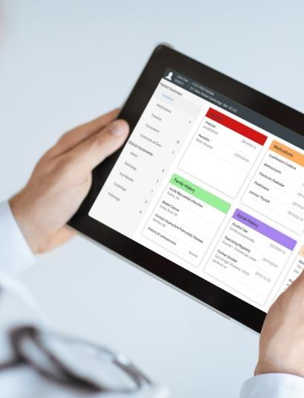

Crawford
Technologies
CrawfordTech is a global software company focused on helping enterprises output, digitize and deliver customer communications
Our portfolio and know-how span
the intersection of digital output, content
management and analytics applications
“The work behind the workflow”
Accessibility
Content Services
Enterprise Output
Software and services provider for accessibility strategies and solutions
Optimizing content distribution strategy and
delivering high-value customer communication archive solutions
Transforming and optimizing workflows for all output processes

Slide 3

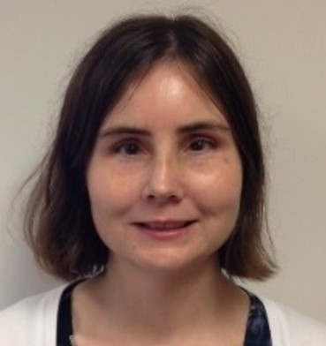
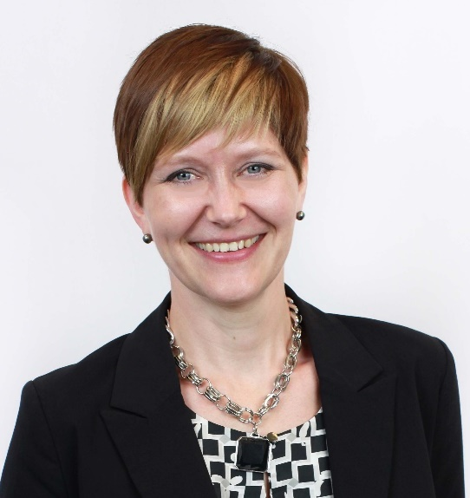
Introductions
Katrina Fox
Marketing Specialist
kfox@crawfordtech.com
Jen Goulden
Project & Quality Manager
jgoulden@crawfordtech.com
Aimée Ubbink
Document Accessibility Specialist
aubbink@crawfordtech.com

Slide 4
Causes of blindness
Diabetes
Macular Degeneration
Aging Population
Born with a disability

Slide 5

Accessibility Considerations for Organizations
Anti-Discriminatory
Aging Population
Compliance and Penalty Avoidance
Customer Satisfaction

Slide 6
Demographics
10% of adult Americans reported having trouble seeing
That 10% is roughly 21.2 million people
Even with corrective lenses, they still have trouble seeing
Notes:
Dennis

Slide 7
Demographics
30 million people in the EU are blind or partially sighted
More than 1 million Canadians are blind or partially sighted
Dyslexia affects 15% of North America
Notes:
Dennis

Slide 8

Blindness is a continuum

Slide 9
What people think blind people see

Slide 10
Future Projections
Blindness is expected to increase dramatically
Aging population is susceptible to macular degeneration or glaucoma
Diabetes diagnosis is increasing, a risk factor for eyesight loss
Notes:
Typically Alternate formats only represent 3-4% of all documents in an accommodation setting
More realistic numbers are 15-20%

Slide 11
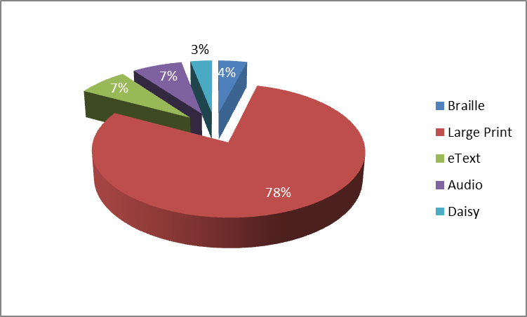
Format Percentages
No one format that meets everyone’s needs

Slide 12

Compliance
Notes:
Meeting compliance by offering digital accessible docs.
[Image] Compliance

Slide 13

Accomodation
Notes:
Offering alternate formats as an accommodation
Need to offer alternate formats not as a preference but as a requisite.
[Image] Accommodation

Slide 14

Systematically Generated Documents
Notes:
Transform based – Automated – PDL to Alternate format

Slide 15
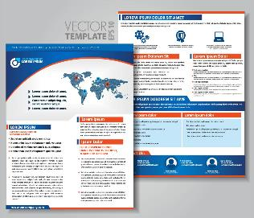


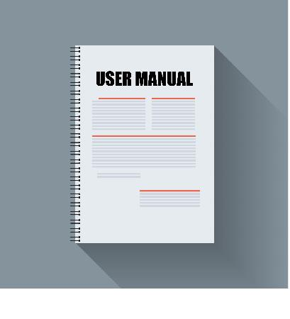
Published Documents
Notes:
Manual remediation – Static – Brochure ware, one-off documents

Slide 16
Traditional Alternate
Format Set up
Transcribe
Proof
Edit
Publish Alternate format
Input
Repeat for
each document
request
Notes:
Manual transcription – slow, costly and untimely

Slide 17
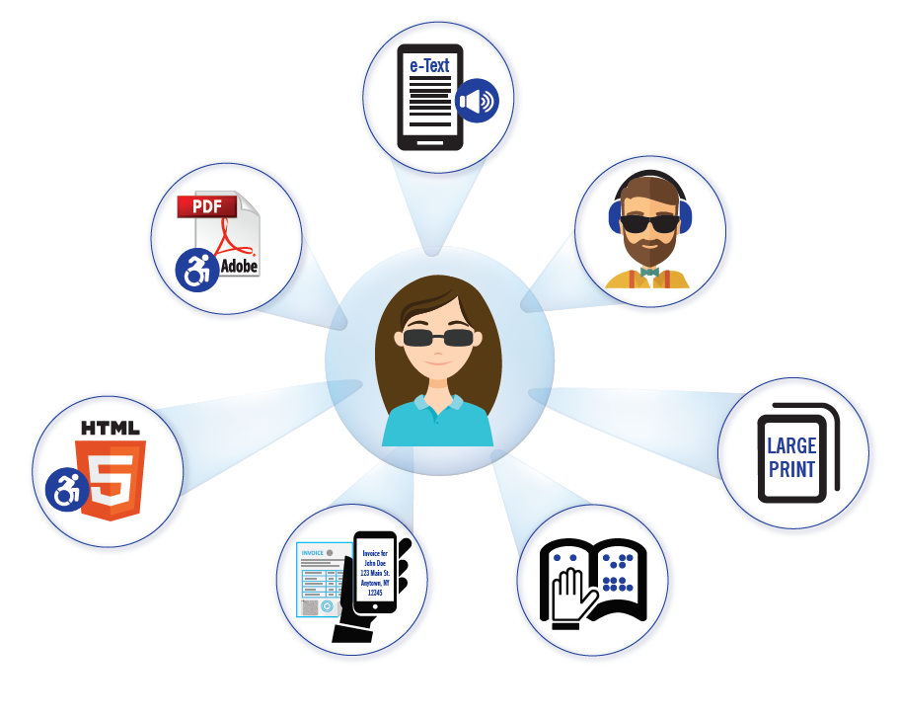
MasterOne
A single setup for all accessible formats
Saves time and expense
Underlying architecture for all CrawfordTech accessibility solutions & services

Slide 18

QUIZ
What do you need to start an automated templated solution?
What is the difference between systematically generated documents and published documents?

Slide 19

Obstructed Image – Macular Degeneration

Slide 20

Obstructed Image – Macular Degeneration

Slide 21

Obstructed Image – Macular Degeneration

Slide 22
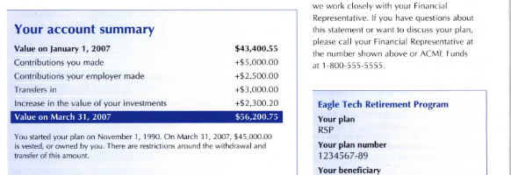
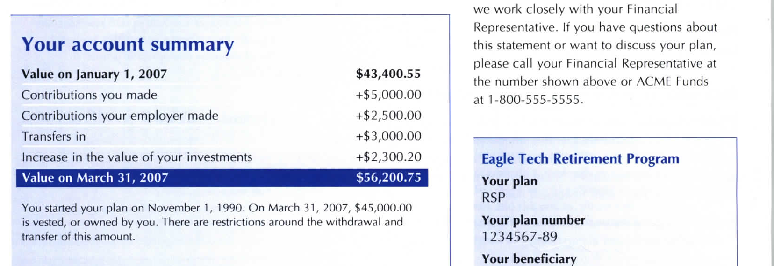
Accessible Document Challenges
Photocopy enlarged doc
Original Doc

Slide 23



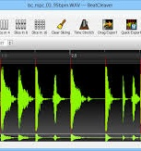

Alternate Formats
Large print
Braille
Audio
E-Text
DAISY

Slide 24
Macular Degeneration on Enlargement

Slide 25
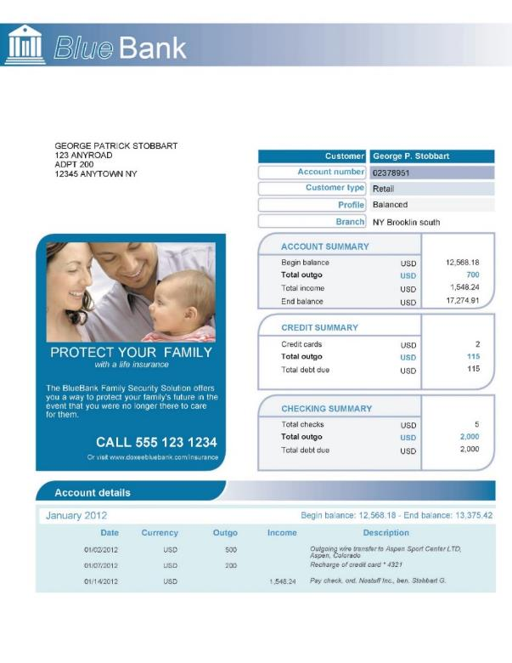
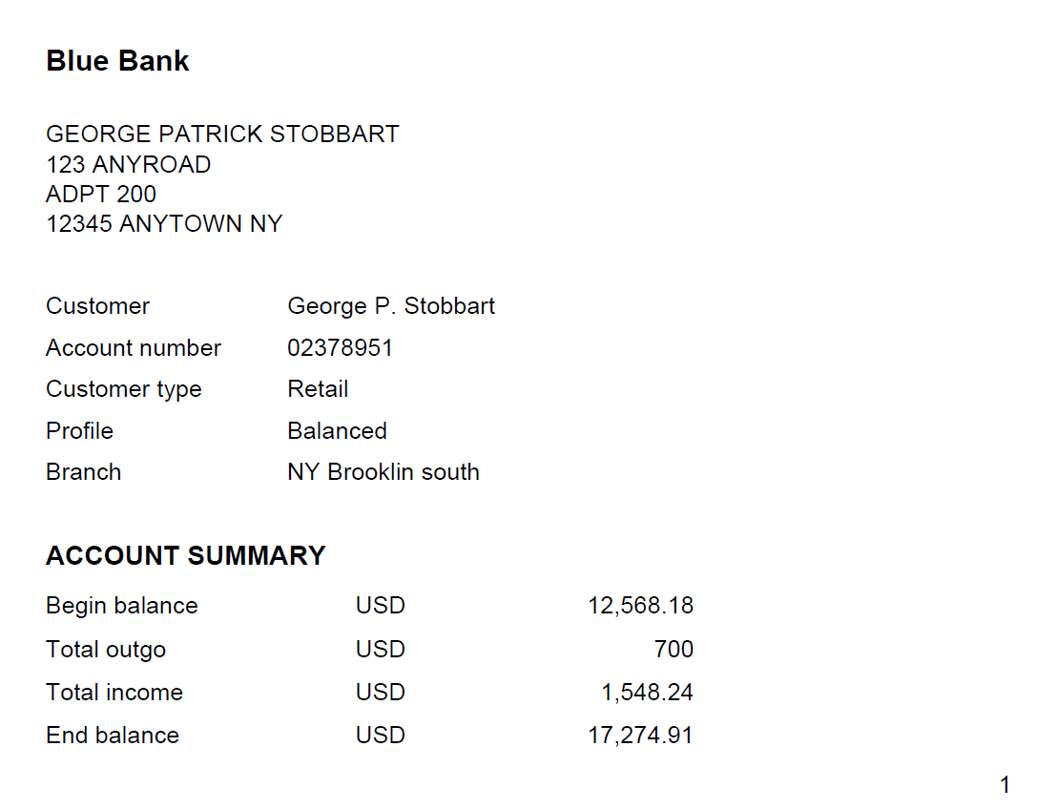
Large Print to the Clear Print Standards

Slide 26
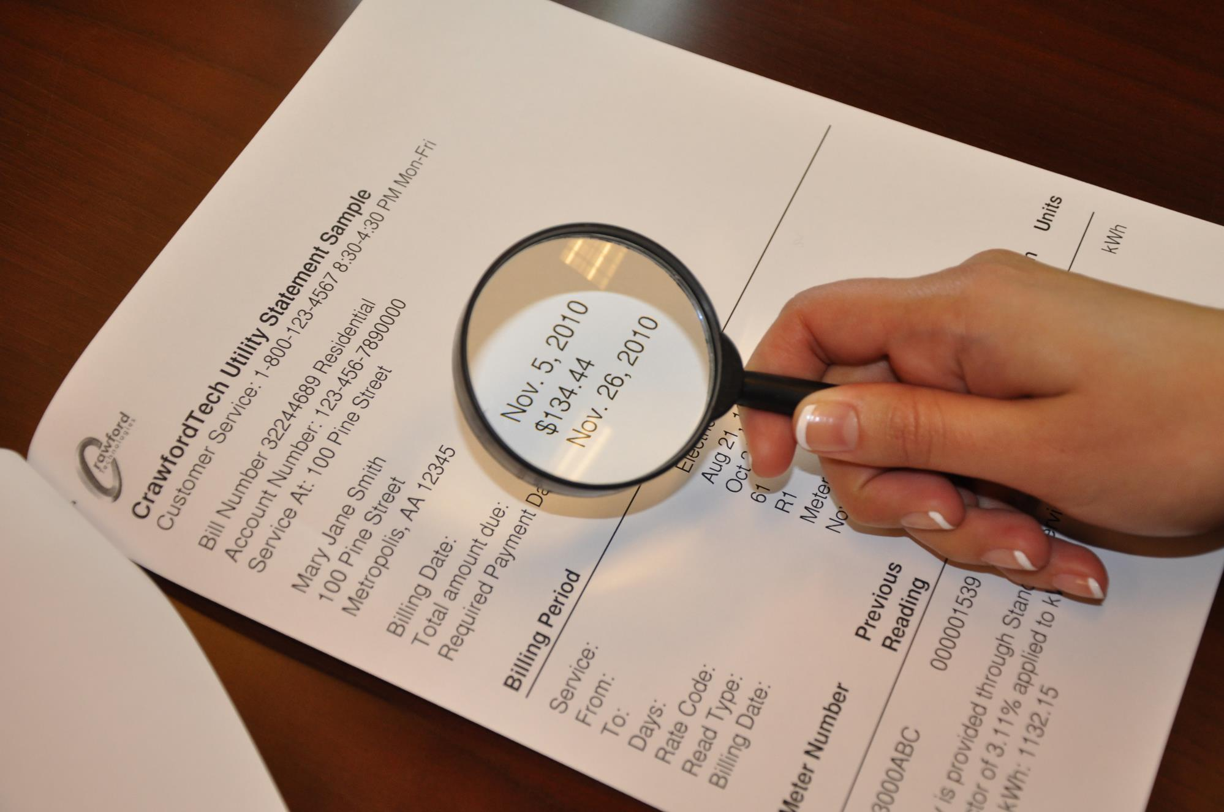
Clear Print Standards
CNIB
Clear Print Guide
RNIB
Large Print Clear Print
AFB
Making Print More Readable
APH
Guidelines for Print Document Design

Slide 27

Clear Print Standards
http://www.cnib.ca/en/services/resources/Clearprint/Documents/CNIB%20Clear%20Print%20Guide.pdf
https://help.rnib.org.uk/help/daily-living/technology/large-print-clear-print
http://www.afb.org/info/reading-and-writing/making-print-more-readable/35
https://www.aph.org/research/design-guidelines/

Slide 28
Large Print
Most widely requested format
Not just an increase in font size or photocopying enlargement
It involves changes to font and formatting and content read order
Using a photocopier to increase the size of the document just increases the size of the problem
Information displayed in columns needs to be reformatted
Blindness is a continuum and many are partially sighted and read large print
It is also requested by seniors losing their vision
Clear Print guidelines followed – set out by APH, CNIB, RNIB

Slide 29
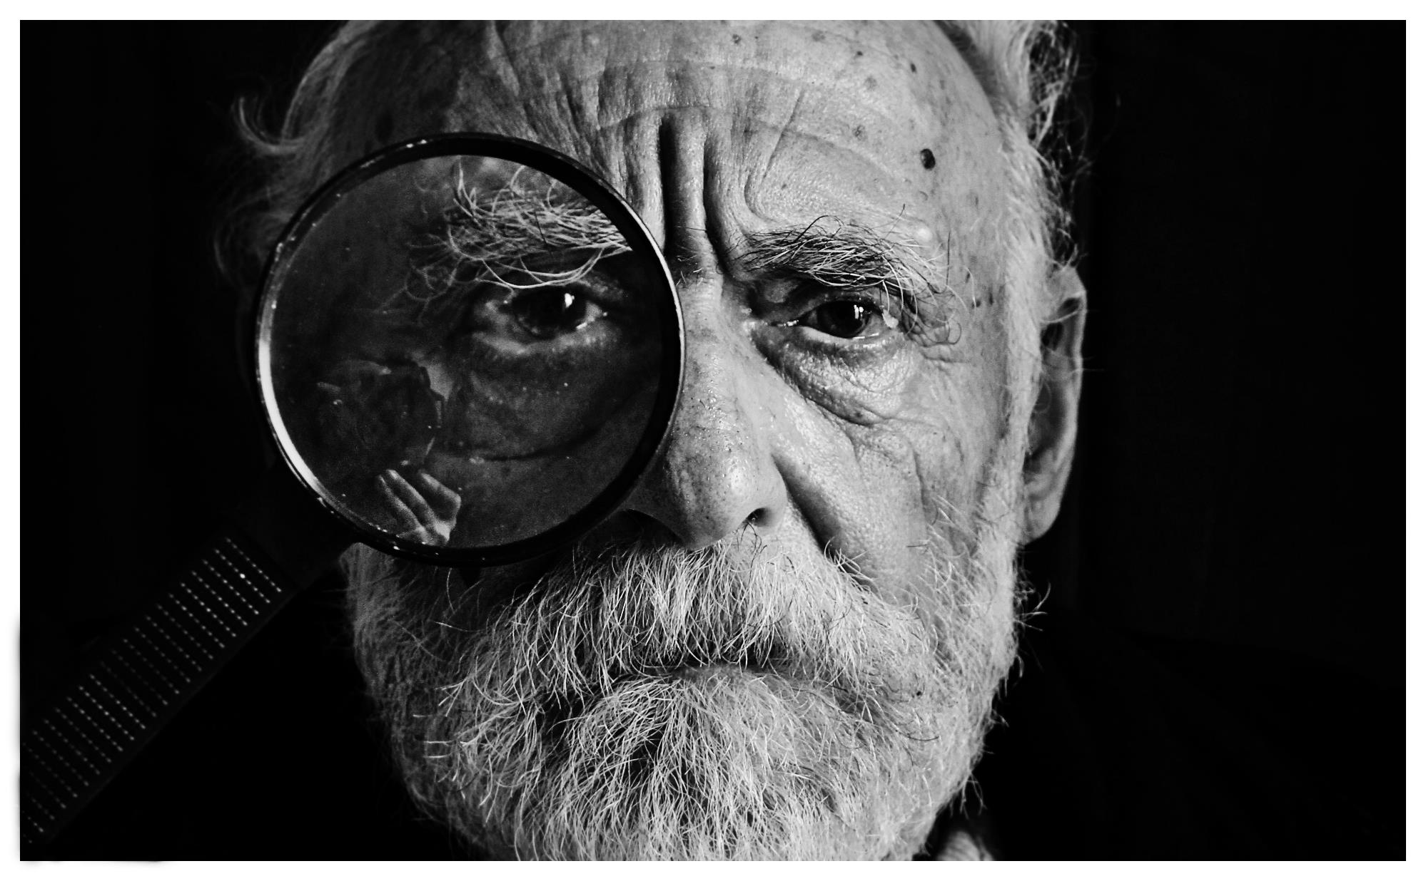
Magnifiers – Magnifying glass

Slide 30
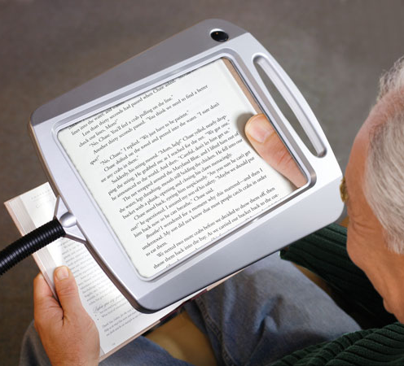
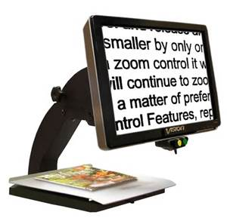
Magnifiers

Slide 31
QUIZ
True or False?
Providing a photocopy enlarged statement makes the content accessible for those who read large print.

Slide 32
QUIZ
Why is large font, enlarged print not acceptable?

Slide 33

Braille

Slide 34

Braille
Contracted vs. uncontracted
Contracted tends to be the default
Providing both is recommended
Electronic or hard copy
Unified English Braille (UEB)
Braille Authority of North America and Braille Literacy Canada

Slide 35

Audio

Slide 36

Audio
Delivered on CD/Cassette/thumb drive or as MP3 / .WAV file
Human or computer-generated voice
Requested by people losing their vision
Also requested by those with print-related disabilities such as dyslexia

Slide 37

Etext

Slide 38

E-Text
Plain text delivered on CD
Can be accessed using a screen reader (text-to-speech) and/or a refreshable braille display
Client can choose how to access the information

Slide 39


DAISY

Slide 40







Standards, Advocacy and Governing Bodies
Notes:
Jen

Slide 41
QUIZ
Why do we need to provide alternate formats?

Slide 42
QUIZ
Braille is made available in ____ and _____.

Slide 43
QUIZ
Why is it important to offer both contracted and uncontracted braille?

Slide 44



Accessible Electronic Document Formats

Slide 45
Inaccessible document:
Text rendered by
Screen Reader
Mon, 16 Sep 2013
ID #. 11053
Juliet, Ashton
Policy:
11 Royal Oak Cres.
Claim:
Ottawa, ON
File
Z9H 3Z7
Last Statement : 19-Jul-2013
Accident Date:
Statement of Account
From : 20-Jul-2013 to 16-Sep-2013
table with 6 columns and 3 rows
Date
Ref. Date
Provider Description
Fee
Payment
Balance
BALANCE FORWARD
0.00
0.00
0.00
table end
BALANCE DUE: 16-Sep-2013 0.00

Slide 46

Accessible Digitization
99% of organizations in North America achieve compliance with WCAG 2.0 AA, not PDF/UA
99% of organizations in the EU are asking for PDF/UA
Notes:
Proliferation of Mobile Devices and low cost refreshable braille

Slide 47
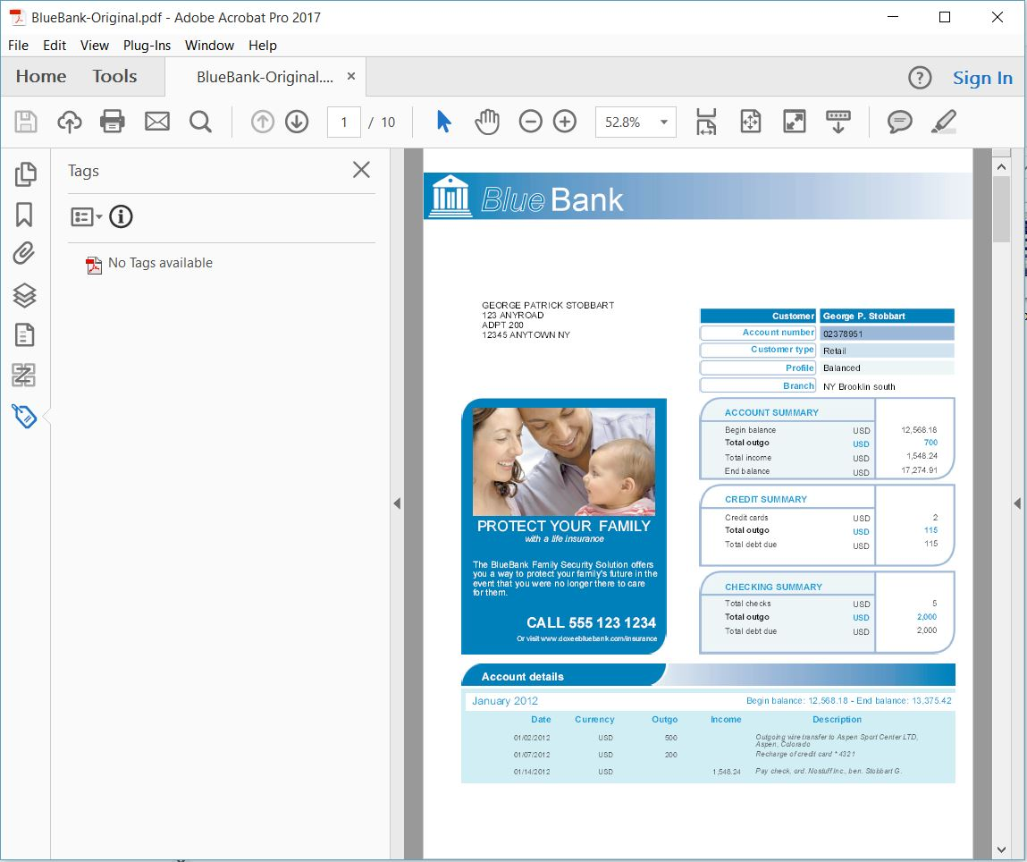
Untagged PDF

Slide 48
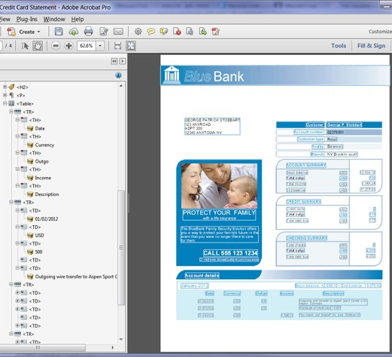

Accessible PDF

Slide 49
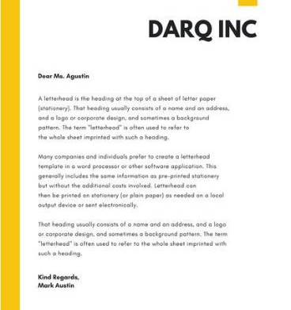
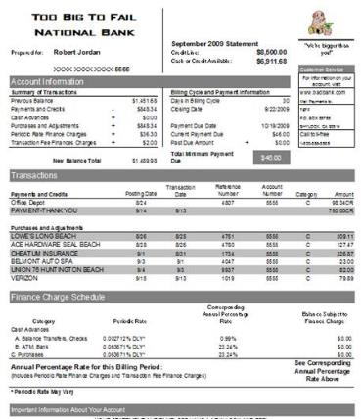

Accessible PDF incremental file size
Simple Document
5-10% larger
Text and logo (letter, correspondence)
Medium complexity
10-20% larger
Credit card, Telco Bill
Complex Documents
up to 50% larger
Auto Policy, Tax forms

Slide 50
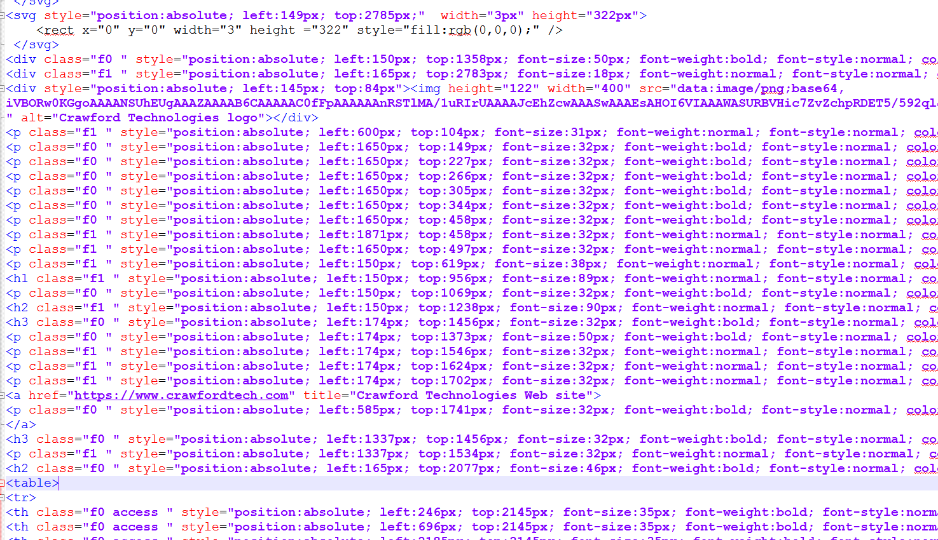

Accessible HTML 5
Accessible

Slide 51
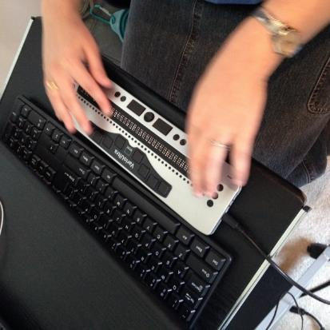
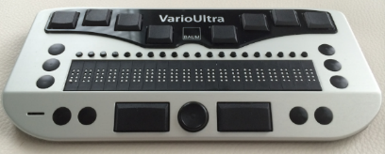
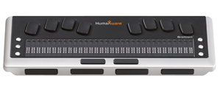
Assistive Technology – Braille Displays
Notes:
Items seen in braille that are not available in the screen reader

Slide 52



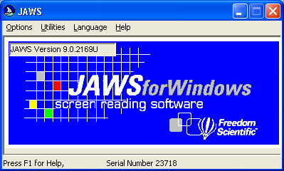


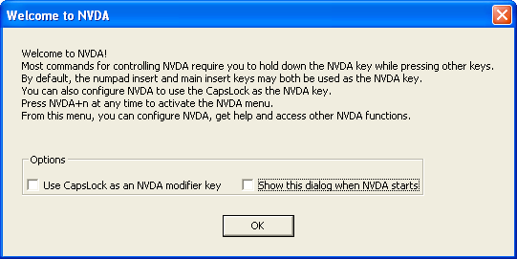
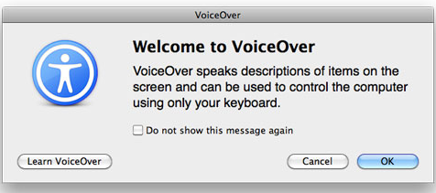
Assistive Technology – Screen Readers
Notes:
Screen reader configuration (verbosity) e.g. table summary (Users don't always maintain the recommended settings)
What it is, products (Jaws, NVDA, VoiceOver, Window Eyes)
What not to use (Adobe Read Aloud)
Do you or do you not force the user experience and why or why not

Slide 53
QUIZ
How do tags in an Accessible PDF facilitate navigation using assistive technology?

Slide 54
Accessible PDF
WCAG
PDF Techniques for WCAG 2.0
HHS
Making Files Accessible
PDF/UA
PDF Association, Competence Centre
Failures for WCAG 2.0
PDF/UA
WebAim
Web Accessibility In Mind
Section 508
Compliant PDF’s
Resources
Crawford Technologies does officially not endorse the sites above, the use of these sites are for resource purposes only and are to be used at your own discretion.

Slide 55
Accessible PDF
WCAG
https://www.w3.org/TR/WCAG-TECHS/pdf.html
HHS
https://www.hhs.gov/web/section-508/making-files-accessible/index.html
PDF/UA
https://www.pdfa.org/working-group/pdfua-competence-center/
https://www.w3.org/TR/WCAG20-TECHS/failures.html
https://www.pdfa.org/category/pdfua
WebAim
http://webaim.org/resources/contrastchecker/
Section 508
http://www.the508compliantpdf.com/
Resources
Crawford Technologies does officially not endorse the sites above, the use of these sites are for resource purposes only and are to be used at your own discretion.

Slide 56

Standards and Guidelines
WCAG
WCAG 2.0 AA has now become the most prevalent guideline
WCAG 2.1 just released
WCAG, Web Content Accessibility Guidelines
Set up by the W3C – followed by many accessibility guides and laws (AODA, ADA, Section 508)
WCAG Ensures Web Accessibility, Set of standards for websites, Set of guidelines for documents

Slide 57
Standards and Guidelines
PDF/UA
PDF/UA is a standard (ISO 14289-1)
PDF/UA is aimed at Documents
PDF/UA Normative and defined standard for Accessible PDF
PDF/UA Provides standard for developers to configure assistive technology software/devices

Slide 58

Standards and Guidelines
HHS
HHS is based on the refreshed WCAG 2.0 (WCAG 2.1 pending)
HHS has policies, requirements and standards in addition to Section 508
HHS Checklists are the official HHS Accessibility checklists
HHS For any electronic document distributed via email or posted online, internally to the Government or externally must comply with Section 508 guidelines and the checklists

Slide 59
QUIZ
What are the differences between HHS, PDF/UA and WCAG?

Slide 60


Thank You

Slide 61
Questions
Why is it important to offer both contracted and uncontracted braille?
Why is large font, enlarged print not acceptable?
Braille is made available in ____ and _____?
Why do we need to provide alternate formats?
What are the differences between HHS, PDF/UA and WCAG?
What do you need to start an automated templated solution?
What is the difference between systematically generated documents and published documents?
True or False? Providing a photocopy enlarged statement makes the content accessible for those who read large print.
How do tags in an Accessible PDF facilitate navigation using assistive technology?

