Slide 1
Automating Accessible PDF Documents
Module 5
Notes:
1_Title Slide

Slide 2
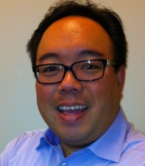
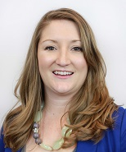
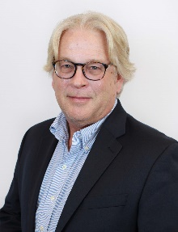
Meet us
Dennis Quon EDP
Director, Document Accessibility Services
Crawford Technologies Inc.
Katrina Fox
Marketing Coordinator,
Crawford Technologies Inc.
Scott Baker
Executive Vice President
Crawford Technologies Inc.
2
Notes:
Thanks for allowing me to chat with you about accessible documents today

Slide 3
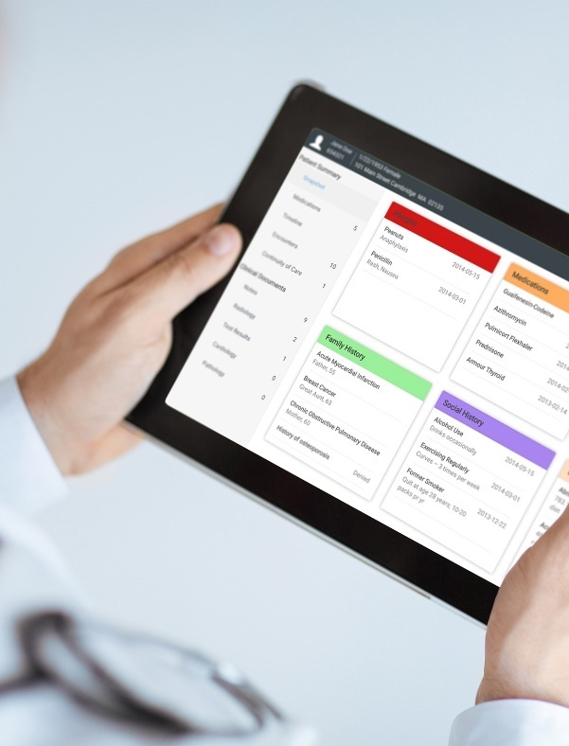
Crawford Technologies
CrawfordTech is a global software company focused on helping enterprises output, digitize and deliver customer communications
Our portfolio and know-how span the intersection of digital output, content management and analytics applications
“The work behind the workflow”
Accessibility
Content Services
Enterprise Output
Software and services provider for accessibility strategies and solutions
Optimizing content distribution strategy and
delivering high-value customer communication archive solutions
Transforming and optimizing workflows for all output processes

Slide 4
State of Accessible Documents
My documents are not compliant
High volume documents cannot be done – too costly with current technology – we are manually remediating
I’m ignoring the issue
My documents are compliant – I’ve got a solution
Notes:
So where are your documents today? Do you produce high volume documents? Do you present on the web? Generally we can bucket everything into four buckets “I’m ignoring the issue”, “My documents are not compliant”, “High Volume documents cannot be done so we are remediating or accommodating”. “My documents are compliant and we have a solution”

Slide 5
The Challenge
Accessible PDFs – never fast and no easy button
Training accessibility for all web / documents across the enterprise
Ensuring compliance
How best to deliver
Turnaround
Process
Scalability = growth $$$
Managing Peak

Slide 6
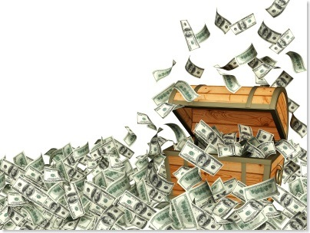
What are the challenges to making documents accessible?
Too many documents
No automated tagging?
Tools are expensive
Labor is costly
Not my job
Outsourcing on a per page basis is very expensive
Time
Understanding tagging requirements
Government – ICT Refresh or new Section 508
Integrating content – external sources

Slide 7
Insurance
Correspondence
Notices
Policies
Plan Summaries
Brochures
Renewals
Claims documents
Benefits documents
Annual Reports
Government
Government documents
Program descriptions
Service descriptions
Tax Bills
School Budgets
Voting instructions and ballots
Correspondence
Education
Courseware
Enrollment documents
Correspondence
Notices
Transcripts
Scholarships, grants, financial aid documents
Program descriptions
Healthcare
Discharge instructions
Admittance documents
Billing documents
Insurance coverages
Application forms
Benefits documents
Prescriptions and drug information
Financial Services
Account Enrollment documents
Welcome Kits
Brochures
Loan documents
Statements
Correspondence
Invoices
Investor information
Newsletters

Slide 8
Technology to Human Comparison
Auto Tagging with Post Remediation
Desk Top Remediation
Speed
Off Shoring
Manual Remediation
Cost

Slide 9
Accuracy vs Time
Auto Tagging with Post QA
Manual Remediation
Accuracy
Auto Tagging
Template Tagging
Desk top Auto Tagging
Time

Slide 10
Questions
What is offshoring and is it sustainable or scalable?
What is the most cost efficient process?
What are the ideal documents that will fit into the AutoTagger environment?
Why do you always need to QC, QA and even touch up documents?

Slide 11
The Right Solution for the Document
Transactional and Variable Content Customer Communications
Business Rules based Post Composition tools – High Speed, High Volume
Static Documents
Marketing Information, Office Documents, InDesign
Auto Tagger Solutions – Adobe Acrobat, Auto Tagger for Accessibility

Slide 12
Ideal Documents
Published documents well engineered
Fonts are embedded
Content has a clear layout
Style sheets are applied
Clear headers, consistent fonts and point size are used to distinguish hierarchy. (Not just colours)
Consistent formatting throughout the document
Consistent use of bullets and spacing
Text based PDFs (Scans are not going to work)

Slide 13
Center of Excellence
Create an internal organization to address tagging, QA and QC
Training your whole organization to do this is probably not ideal.

Slide 14
Manual Remediation
Very slow
Costly
Need labor
Space
No Security - generally

Slide 15
Organizations – where are we?
Accessibility continues to be outside of dedicated requirements – for most organizations ….
Accessibility is an after thought
Accessibility belongs to compliance and the accessibility department

Slide 16
What do I do if I have one document that needs to be made accessible?
I’ve got a board meeting or town council budget meeting – I need my report made accessible now

Slide 17
Differences Between Manual and Automated Tagging

Slide 18
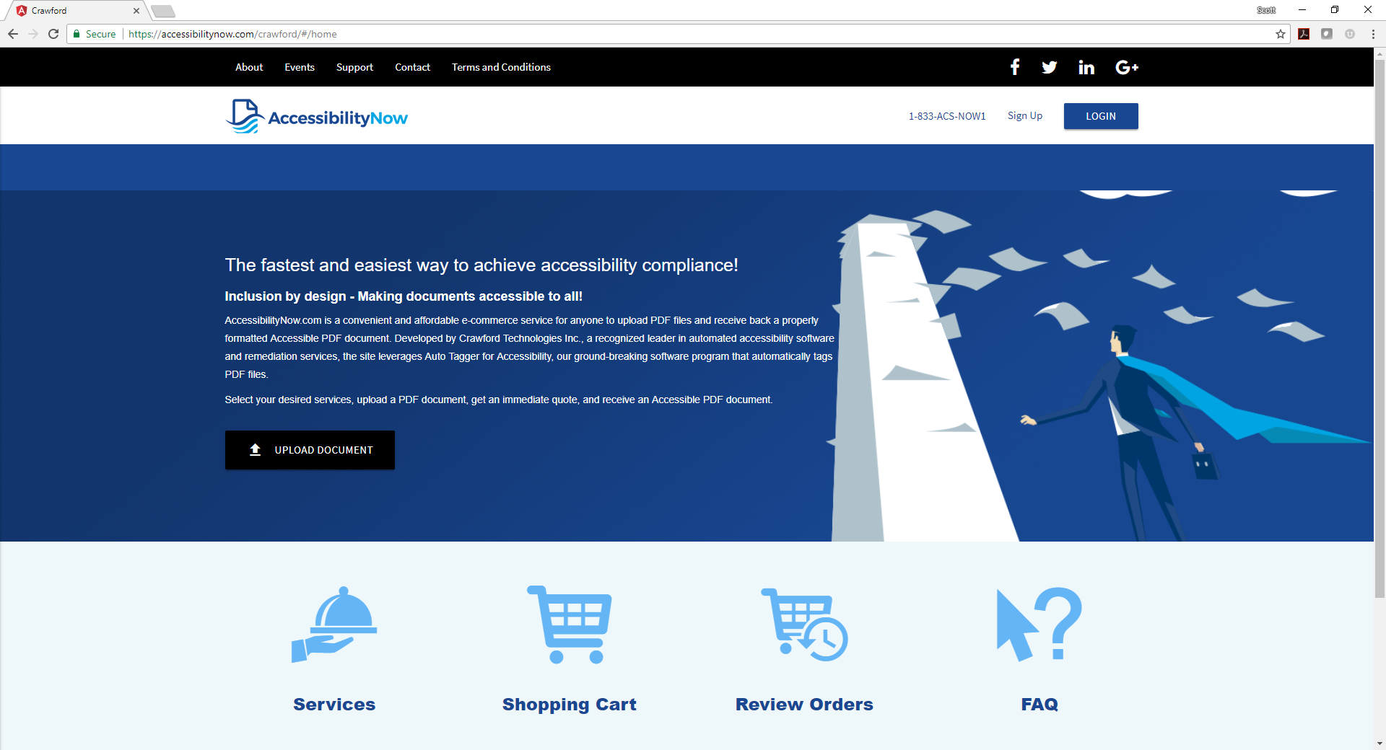

Slide 19
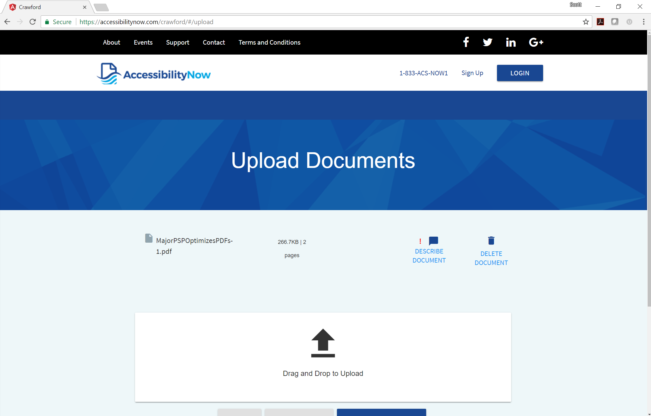

Slide 21
Pitfalls

Slide 22
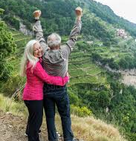
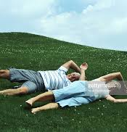
Pitfalls – ALT Text

Slide 23
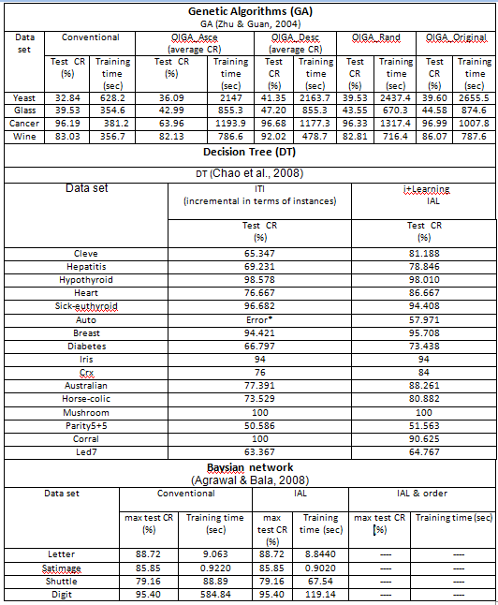
Complex Tables

Slide 24
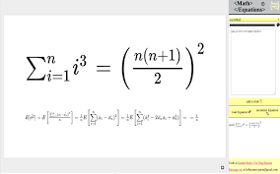
Mathematical / Symbology

Slide 25
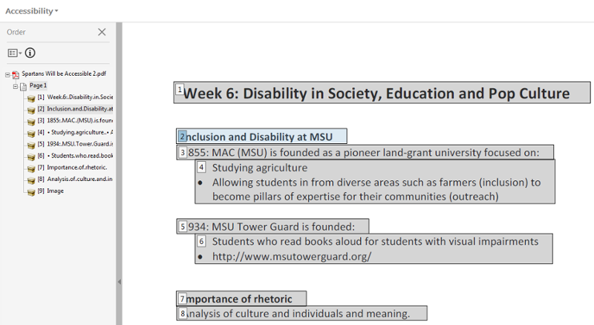
Read Order

Slide 26
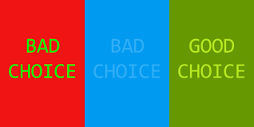
Contrast

Slide 27
Scanned Text

Slide 28
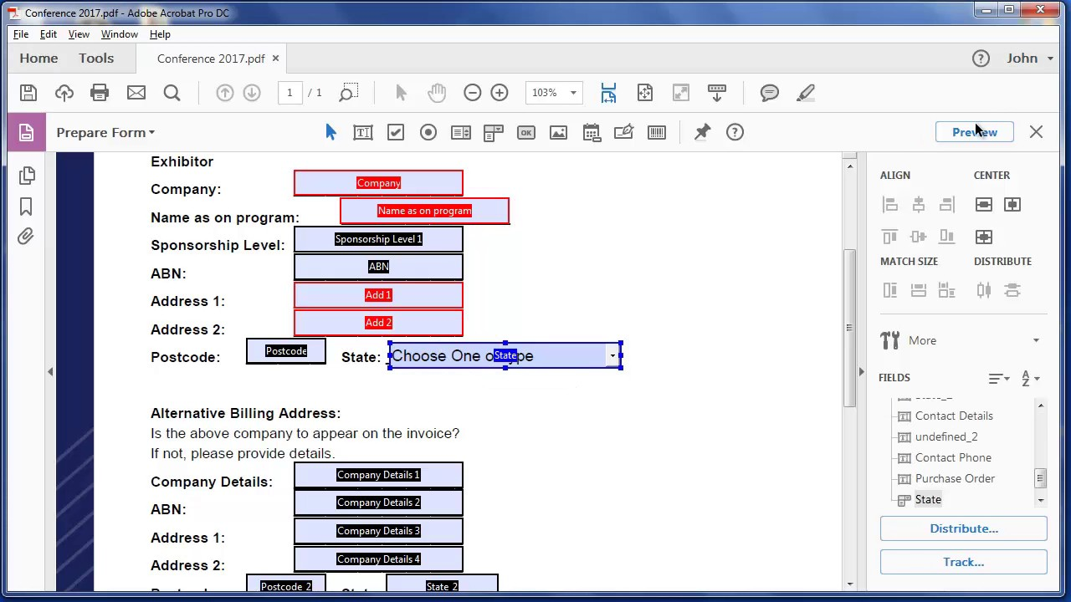
Fillable Forms
Hours of remediation
Very expensive

Slide 29
Questions
Why does color contrast matter?
Can alt-text ever be automated?
What does Assistive Technology do with scanned content?
Why does scanned text pose a problem for AT?
Why is checking the read order after autotagging important?
Will autotagger work to clear backlogs of untagged PDFs?

Slide 30
Testing – Quality Assurance / Control
Human based testing
Assistive technology
Electronic testing – PAC 3.0, Adobe Acrobat PRO
USEABILITY VS ACCESSIBILITY/Compliance

Slide 31
I’ve got lots of office documents to be made accessible
We have a back log
We don’t have trained resources
Our accessibility department is working on web projects
Document accessibility is not easy
Manual remediation takes too long

Slide 32
AccessibilityNow Publisher
Completely automates converting unstructured documents to accessible PDF or HTML in real-time
Eliminates the manual remediation/tagging step by doing it automatically using intelligent algorithms
Cuts cost in half for ad hoc usage
Reduces turnaround times from days to minutes
Notes:
CrawfordTech to the rescue with automated intelligent tagging

Slide 33
Auto Tagger for Accessibility
Scalability, time and cost savings

Slide 34
Auto Tagging – Server solution
Hundred of pages per second to Hundreds per minute

Slide 35
Auto Tagger for Accessibility – Server Solution
Reduce training and become compliant
Can be automated like a drop box
Users can upload and pull from an outbox or routed
Or
Files your system generates
Document Transform Process and AccessibilityNow Publisher

Slide 36
Considerations
Achieves a high percentage of tagging compliance
Like all tagging, QC is required
100% compliance can be very iterative
Scanned or graphics need secondary remediation for ALT Text
Complex tables – tables in tables are problematic
Single line .ACF for higher accuracy
Notes:
Wasn’t the word “pitfalls” going to be changed? I forget what Jen suggested

Slide 37
Thank You
Notes:
1_title slide

