Slide 1
Assistive Technology
Notes:
1_Title Slide

Slide 2
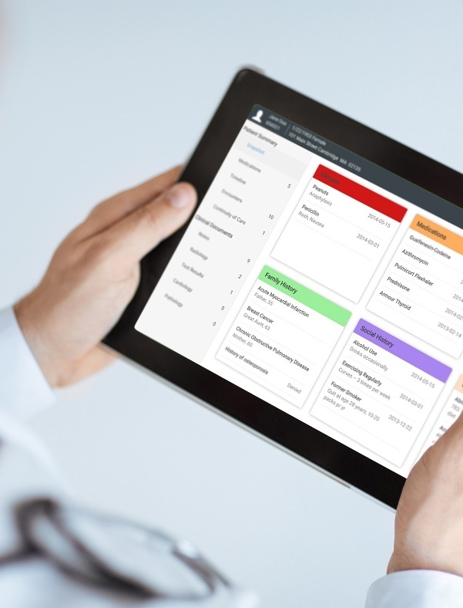
Crawford Technologies
CrawfordTech is a global software company focused on helping enterprises output, digitize and deliver customer communications
Our portfolio and know-how span the intersection of digital output, content management and analytics applications
“The work behind the workflow”
Accessibility
Content Services
Enterprise Output
Software and services provider for accessibility strategies and solutions
Optimizing content distribution strategy and
delivering high-value customer communication archive solutions
Transforming and optimizing workflows for all output processes

Slide 3
Introductions
Katrina Fox Marketing Specialist kfox@crawfordtech.com
Jen Goulden Project & Quality Manager jgoulden@crawfordtech.com
Aimée Ubbink Document Accessibility Specialist aubbink@crawfordtech.com

Slide 4
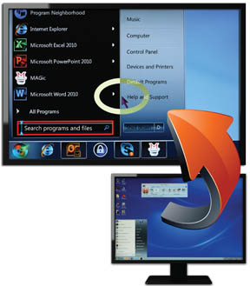
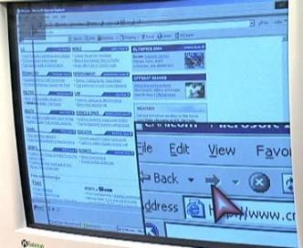
Assistive Technology – Screen Magnification
MAGic
ZoomText
Supernova
iReader
Eye-Pal
Dolphin
Notes:
Screen reader configuration (verbosity) e.g. table summary (Users don't always maintain the recommended settings)
What it is, products (Jaws, NVDA, VoiceOver, Window Eyes)
What not to use (Adobe Read Aloud)
Do you or do you not force the user experience and why or why not

Slide 5
Magnifiers
Notes:
[Image] Young boy reading a map with a magnifier and light

Slide 6
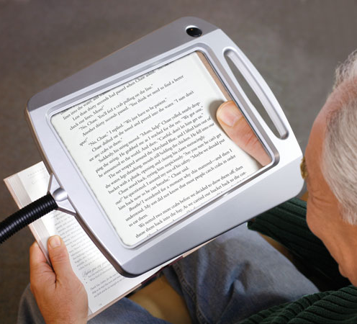
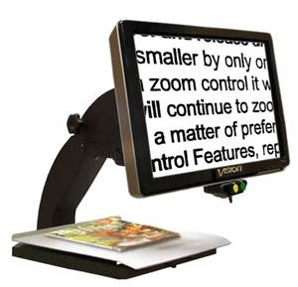
Magnifiers

Slide 7
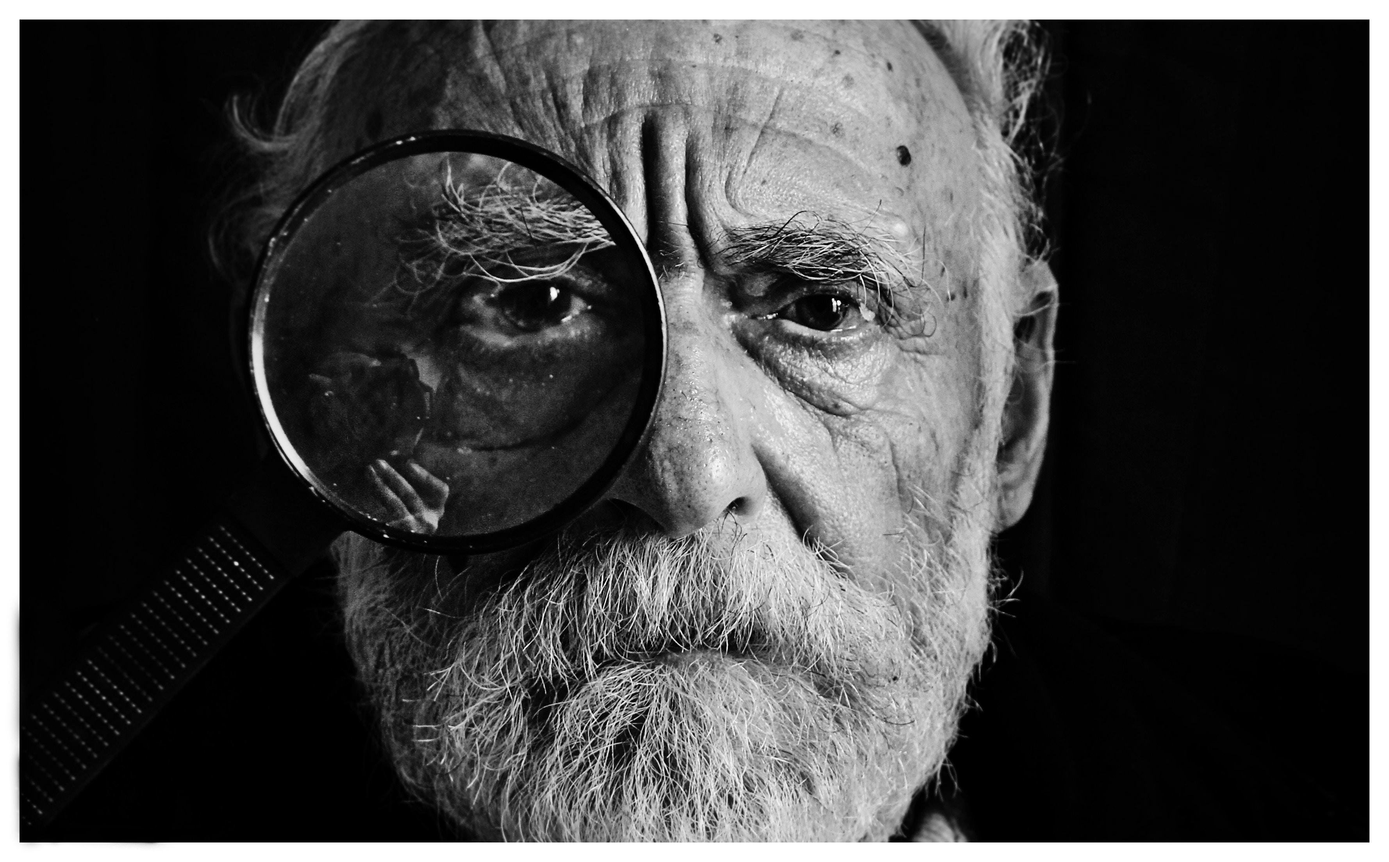
Magnifiers – Magnifying glass

Slide 8
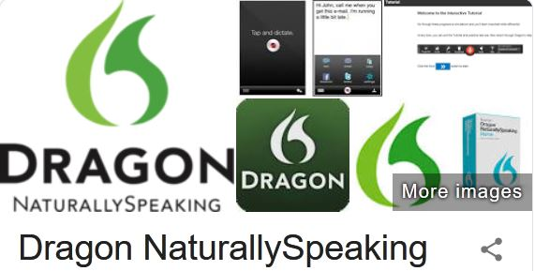
Assistive Technology – Speech Recognition
Dragon NaturallySpeaking
SpeechGear’s Interact
SpeechMagic
Kurzweil
Apple – Siri
Android – SpeechTexter/SpeechNotes

Slide 9
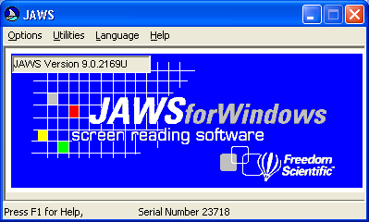
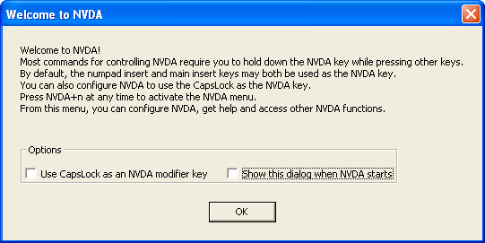
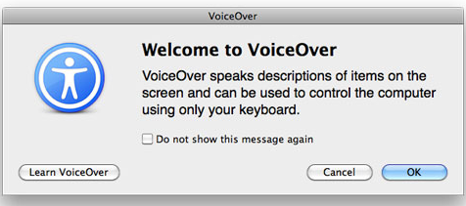
Assistive Technology – Screen Readers
Notes:
Screen reader configuration (verbosity) e.g. table summary (Users don't always maintain the recommended settings)
What it is, products (Jaws, NVDA, VoiceOver, Window Eyes)
What not to use (Adobe Read Aloud)
Do you or do you not force the user experience and why or why not

Slide 10
Video: Screen Reader Demo
Notes:
Video2-ScreenReaderDemo.mp4

Slide 11
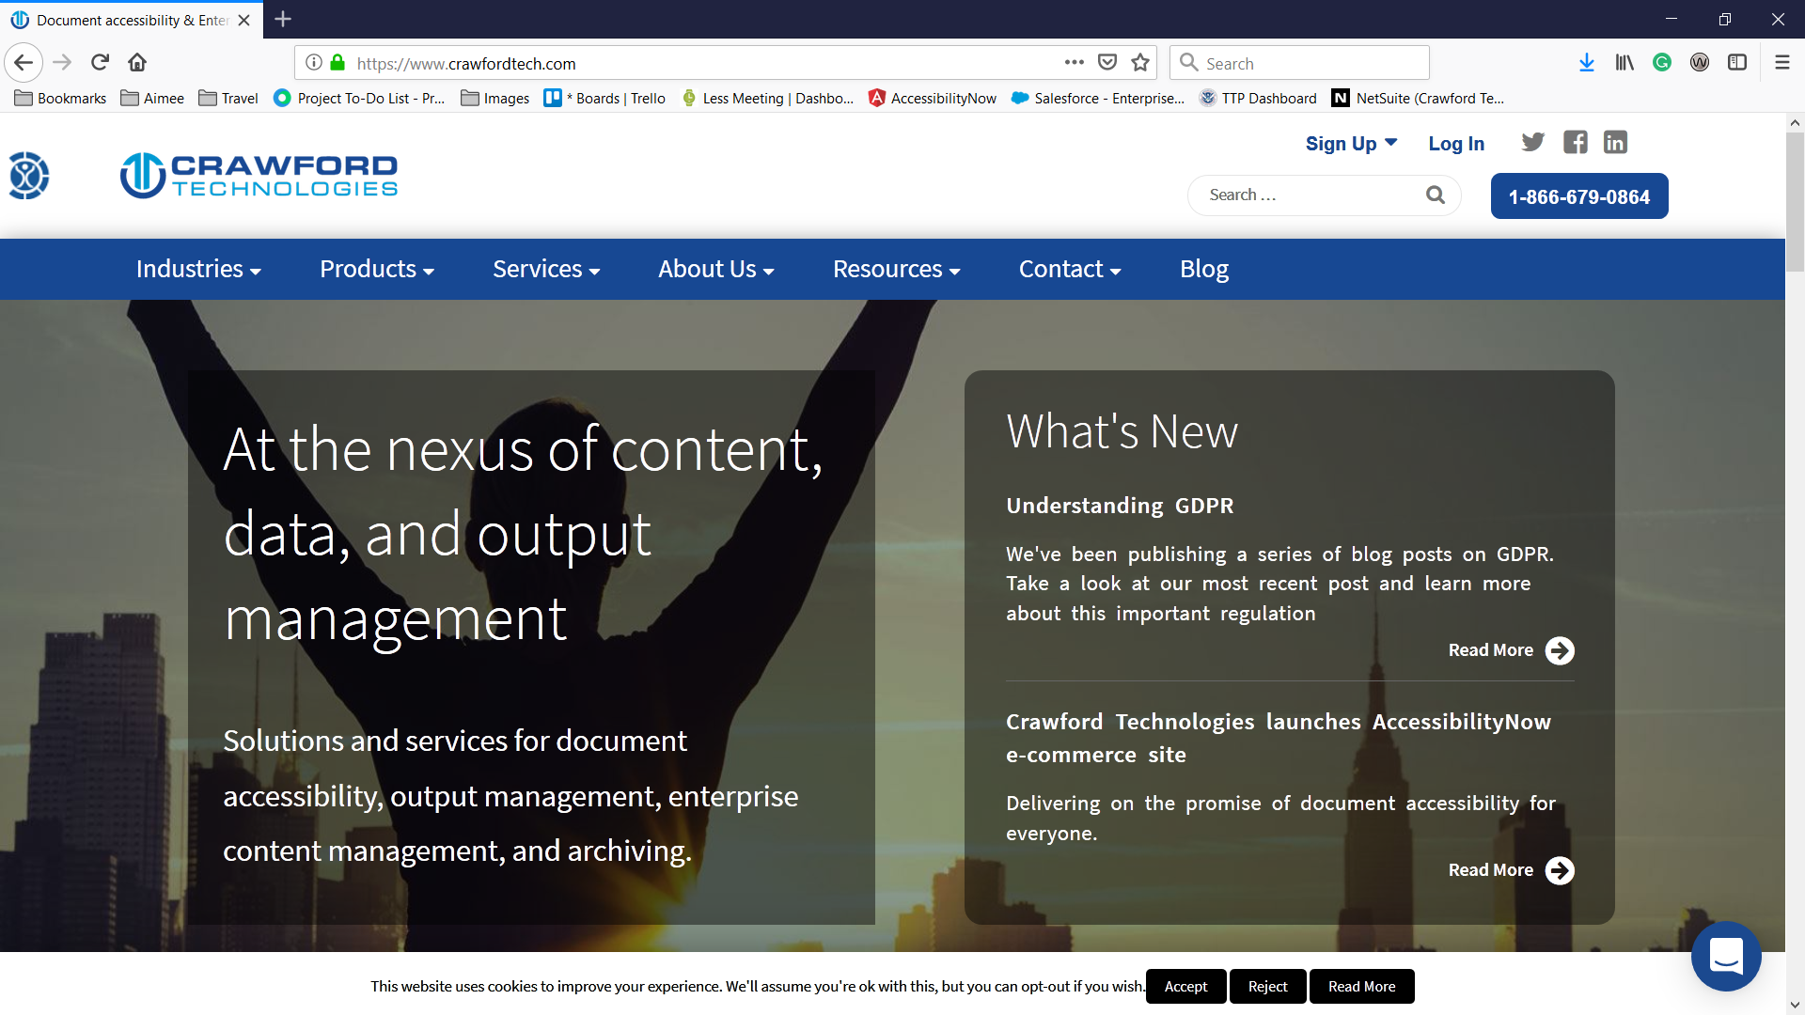
Web Page Navigation

Slide 12
Video: Accessible Web
Notes:
Video4-AccessibleWeb.mp4

Slide 13
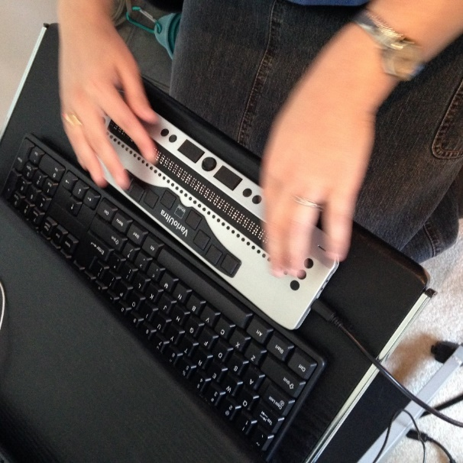
Assistive Technology – Braille Displays
Notes:
Items seen in braille that are not available in the screen reader

Slide 14
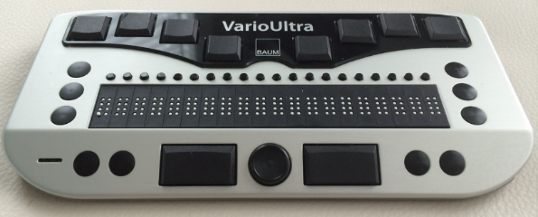
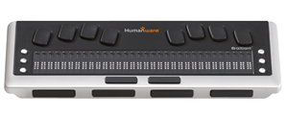
Assistive Technology – Braille Displays
Notes:
Items seen in braille that are not available in the screen reader

Slide 15
Video: Braille Display Demo
Notes:
Video3-BrailleDisplayDemo.mp4

Slide 16
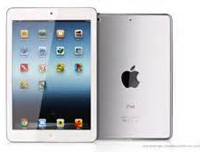
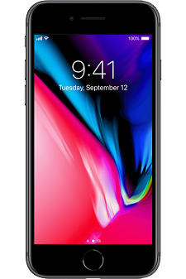
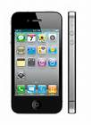
Assistive Technology - VoiceOver / TalkBack
Notes:
Screen reading software
Screen magnification software
VoiceOver with a Mac or iOS devices
Braille displays and notetakers
Braille embossers

Slide 17
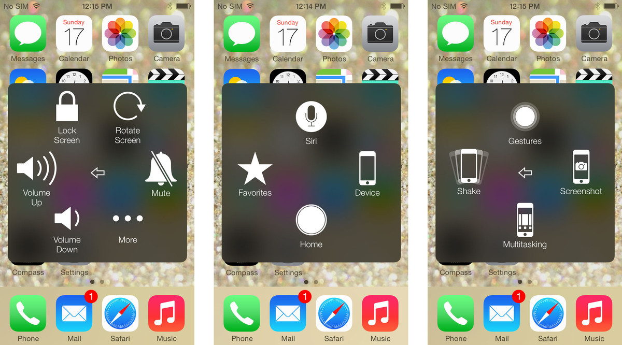
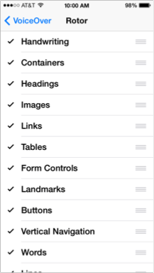
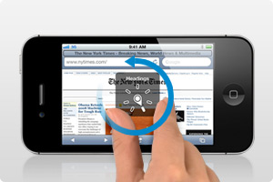
iPhone Accessibility

Slide 18
Video: Voice Over Demo
Notes:
Video6-VoiceOverDemo.mp4

Slide 19
Video: iPhone Navigation with Braille Display
Notes:
Video7-iPhoneNavWBrlDisp.mp4

Slide 20
QUIZ
True or False?
There is only one screen reader

Slide 21
QUIZ
Can the end user control the screen reader speed?

Slide 22
QUIZ
Can end users employ more than one type of assistive technology?

Slide 23
QUIZ
Can braille displays show information in contracted and uncontracted braille?

Slide 24
QUIZ
How does a braille display connect to a smart phone?

Slide 25
QUIZ
A screen reader user can set preferences for which of the following?
Punctuation, numeric output and level of tag feedback
Speech rate
Voices used
Translating languages

Slide 26
Thank You

Slide 27
Questions
A screen reader user can set preferences for which of the following?
Punctuation, numeric output and level of tag feedback
Speech rate
Voices used
Translating languages
Can end users employ more than one type of assistive technology?
Can the end user control the screen reader speed?
True or False? There is only one screen reader
Can braille displays show information in contracted and uncontracted braille?
How does a braille display connect to a smart phone?

