Slide 1
The CrawfordTech Accessibility Value Proposition Case Studies
Module 7
Notes:
1_Title Slide

Slide 2
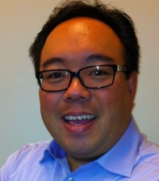
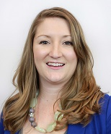
Meet us
Dennis Quon EDP
Director, Document Accessibility Services
Crawford Technologies Inc.
Katrina Fox
Marketing Coordinator,
Crawford Technologies Inc.
Scott Baker
Executive Vice President
Crawford Technologies Inc.
Notes:
Thanks for allowing me to chat with you about accessible documents today

Slide 3
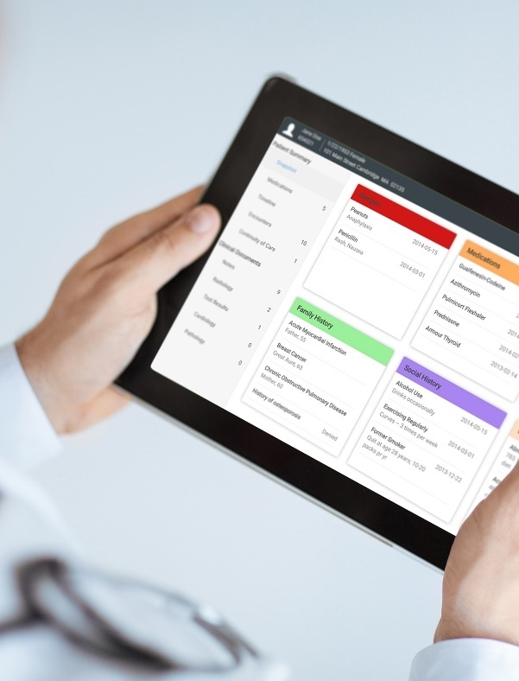
DAS Value Proposition
Meet compliance obligations quickly and economically using CrawfordTech’s end-to-end accessibility portfolio and services
Easily deliver compliant, useable documents to those that need them by leveraging CTI’s know-how and experience deploying solutions
One-stop shop for all accessible formats for all document types
Transactional
Static Documents
Alternate Formats
Strategies and solutions for high volume transactional output and remediation of archived documents
Strategies and solutions/ consulting/ services for internal and customer-facing communications
One stop service bureau for manual and automated remediation to all physical and electronic formats

Slide 4
CTI’s Unique DAS Capabilities
One source for automated software solutions
Accessibility Express
Auto Tagger for Accessibility
One stop Service Bureau for manual and automated remediation
Expert accessibility consulting, services, and training
All accessible alternate formats supported
Braille
Large print
Audio
E-text
Accessible PDF and HTML5
Voiceye barcode
DAISY
E-commerce site for on demand accessible documents (AccessibilityNow.com)
MasterONE architecture for one-time job set-up

Slide 5
Accessibility Express
The Right Solution for Each Type of Document
Transactional and Variable Content Customer Communications. - business rules based post-composition software for high speed, high volume applications.
Auto Tagger for Accessibility
Different types of documents require different strategies, tools, and planning to produce and remediate compliant and useable accessible documents. CTI has developed automated solutions and expertise to address the accessibility scenarios encountered by enterprises.
Marketing Collateral/Brochures/Flyers/ Ad hoc Correspondence/Enterprise Office Documents, Whitepapers/Adobe InDesign – Auto Tagger, AccessibilityNow.com and Adobe Acrobat DC Pro for quality assurance and touch up
DAS Services
Accommodation and manual remediation for all physically accessible document formats – large print, Braille, e-Text, and audio – as well as electronic formats

Slide 6
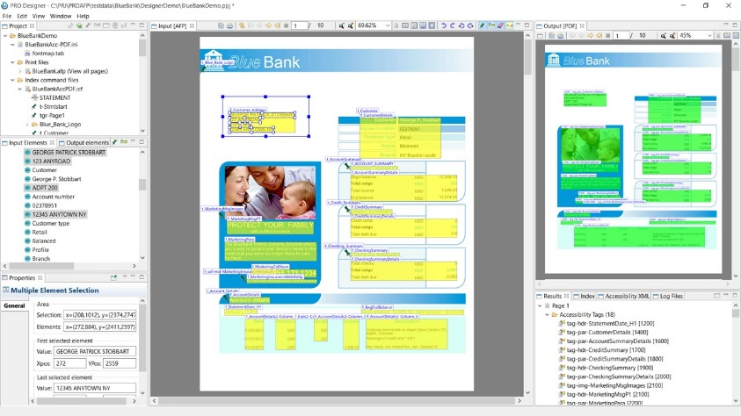
Accessibility Express
Template (rules) based tagging
Remediate documents at archive ingestion
Hundreds of thousands of pages per second
Remediate archived documents on-the-fly
On-demand or batch processing
Best approach for high volume transactional documents

Slide 7
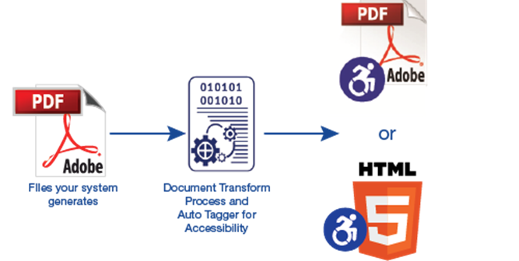
Auto Tagger for Accessibility
On premises server based solution for static documents
Can be automated like a drop box
Users can upload and pull from an outbox or work can be routed
Automates converting unstructured documents to accessible PDF or HTML5 in real-time
Eliminates high percentage of manual remediation/tagging via artificial intelligence
Requires some manual quality assurance
Reduces turnaround from days to minutes
Cuts cost in half for ad hoc remediation

Slide 8
Student loans

Slide 9
Iowa Student Loan
In October of 2014, the National Federation of the Blind reached an agreement with the U.S. Department of Education. All student loan servicing companies contracted with the D.O.E. had to make their communications accessible, providing them in including Accessible PDF, voiceover, and additional popular alternate formats such as Braille, Large Print and others.

Slide 10
Customer Situation
Needed to make electronic communications accessible
Handled high volume – thousands of documents every day
Received PCL print files with no hierarchical structure, written in EBCDIC
Customer Profile | Iowa Student Loan was established in 1979, and since then has helped more than 392,500 pay for college. They employ approximately 200 people, and disburse loans through their privately-owned subsidiary, Aspire Resources.
Industry | Non-profit, linked to government
Location | Iowa, United States
Deal Value | $92,840 excl. maintenance
Close date | August 31, 2014
Competitor/ Incumbent | Actuate - now OpenText
CTI Solution | PRO Transform for Accessible PDF, PRO Designer
Customer Contacts | IT development Manager, IT Systems Supervisor
Customer Challenges
Received already composed print files, with no access to content creation or composition tools
Had to convert thousands of documents quickly and automatically
Did not want to use valuable developer resources for document conversion

Slide 11
THE Process
VALUE DIMENSIONS
CUSTOMER IMPACT
CTI tested and assessed Iowa State’s precomposed partner PCL files (EBCDIC)
CTI took files, tagged and transformed into Accessible PDF for demonstration
Verified that they could be inducted and tagged to produce Accessible PDF to WCAG 2.0.
Participated in competitive bid process, and verified that we could meet customer’s server build, security, hardware and software requirements.
Consulted with Iowa Student Loans and provided training to implement this new transformation into their existing workflow.
Economic Value
Iowa Student Loans risked fines if they were not in compliance.
Strategic Value
Automating the process of creating Accessible PDFs did not require additional resources and the document owners were able to manage tagging in lieu of costly developers, keeping costs down.
Political Value
They were able to provide equal access to personal & confidential documents to partially sighted and cognitively disabled individuals.
Accessible documents are created at speeds of up to thousands per second
Documents are flagged for remediation
Blind, partially sighted and cognitively disabled clients do not need to make requests for accessible documents and don’t have to rely on others to read personal information.
Archived PDFs are converted as they are pulled out of archive, or converted when flagged for delivery.
With PRO Designer, non-developers can tag files.

Slide 12
The Event: Legislation / Rule
In October of 2014, the National Federation of the Blind reached a ground-breaking agreement with the U.S. Department of Education (DOE) regarding document accessibility.
Student loan servicing companies, contracted by the DOE, must make all communications, including forms, websites, and other documents that are part of the DOE’s Direct Loan program, accessible to blind, partially sighted or those clients with cognitive disabilities.

Slide 13
The Challenge
High volumes of loan transaction statements that need to remediated in accessible PDF
Needed to be eDelivered & ePresented
Manual remediation was impossible – too costly and too slow

Slide 14
The Problem
Transaction statements are print ready, supplied by a partner in PCL formatted PDL
No access to data or to reformat composed documents
Limited resources

Slide 15
Requirements
Need a high speed transform to index, split and concatenate files and make them WCAG 2.0 Level AA Accessible at the PDL level
An Accessible Transform to ensure 100% rendering of information

Slide 16
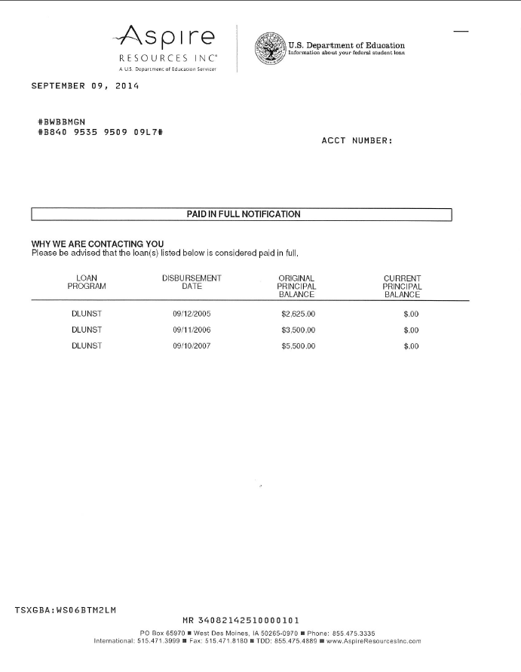
The Solution
Crawford Technologies’ Solution
Pro Transform Plus PCL to Accessible PDF

Slide 17
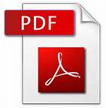
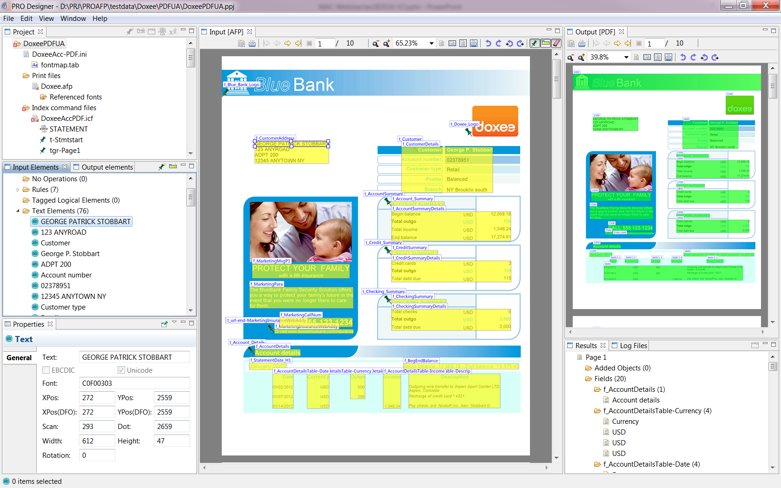
Accessible Documents Workflow
PCL
SPLIT
TAG
MERGE
PRO Transform Plus Accessible PDF
Accessible
PCL
Config File
PCL
Printer files your system already generates
PDF
AFP
META
Other

Slide 18
Large Multi-line Insurance and Financial Services Company
A financial services and insurance corporation focused on military members and families. They have Section 508 regulations. Founded in 1922 they have over 11.4 million members. They have a diversified financial services, that include banking, investing and insurance to people and families that serve, or served in the US military.

Slide 19
Customer Situation
To meet ADA and Section 508, USAA has focused on the best client experience. Already providing Alternate formats, Accessible PDF for eDelivery was needed to support USAA’s clients.
Customer Profile
Company is focused on providing a diversified range of financial, insurance, and banking services to its 11.4 million members who either serve, or served the United States Military.
Industry
Financial Services, Insurance and banking
Texas, United States
Location
Deal Value
$180K
Close date
November 2014
Customer Challenges
Documents created by multiple vendors in AFP format
Offshored services to Tata Consulting
Documents were being redesigned
Competitor
OpenText
Customer contacts
CTI Solution
PRO Transform for Accessible PDF, PRO Designer, Training and additional seats of PRO Designer

Slide 20
THE Process
VALUE DIMENSIONS
CUSTOMER IMPACT
CTI tested and assessed company’s AFP files
Provided a proof of concept on banking statements and insurance policies
Verified that they could be inducted and tagged to produce Accessible PDF to WCAG 2.0 Level AA .
Economic Value
Added eDelivered Accessible documents by automation and not manual remediation.
Strategic Value
Saved cost and opened additional lower cost delivery channel.
Political Value
They were able to deliver accessible documents and gain the internal expertise and technology to continue to meet the growing need for document accessibility.
Existing AFP creation remained the same.
Continued to use their existing archiving & retrieval system.
No application changes were required, allowing them to add document accessibility without additional resources.

Slide 21
CMS – Centers for Medicare and Medicaid Services
CMS provides Medicare and Medicaid coverage to over 100 million people in the USA.
Over the past 2.5 years, CMS sought a provider to provide alternate formats like braille, large print, eText and audio. With such a wide ranging population Medical Statement Notices and Letters needed to be in accessible to be in compliance with Section 508 regulations.
* See Allison Payments for complementary partner solution

Slide 22
Customer Situation
Needed to support Accessible Alternate formats provided and composed by Allison Payments. Support CMS - Department of Health and Human Services for Medicare business. Many document formats leading to potentially many set ups
Short time frame to launch 30 days
Customer Profile
CMS is focused on providing coverage for Medicare and Medicaid as a result of the Affordable Heathcare act.
Industry
Government - Health
Location
Baltimore, Maryland, United States
Deal Value
$640K over 4 years
Close date
April 16, 2016
Customer Challenges
Client depended on another provider for composition and set up
Competitor
Multiple small business alternate format providers
Customer contacts
Government CMS Sourcing
CTI Solution
DAS Service - MasterONE, PRO Transform for Accessible PDF, PRO Designer
UNIQUE CTI Solution
Allison Payment Systems currently generates accessible PDF via CrawfordTech’s PRO Transform Plus Accessible PDF and PRO Designer. With MasterONE, ICFs will generate into XML without the need to set up unique applications – this saves set up time and cost. Allison has provided CrawfordTech and CMS ICF files to generate alternate formats at CrawfordTech’s Potsdam Service bureau.

Slide 23
THE Process
VALUE DIMENSIONS
CUSTOMER IMPACT
CTI tested and assessed CMS files
Files were not normalized and had many variations
CTI determined that Allison Payment Systems was the provider who uses CrawfordTech Accessibility solutions.
ICFs were transferred from Allison to CrawfordTech
Verified that they could be inducted and tagged to produce Accessible Alternate formats via XML
Economic Value
Crawford Technologies won RFP and lowered the cost for conversion.
Strategic Value
Allison Payment Systems is well liked in CMS and this three way partner arrangement benefits all
Political Value
We were able to deliver accessible documents using MasterONE architecture without multiple set ups which may have taken weeks or months
Fidelity and integrity of data with one ICF (MasterONE)
One simple workflow to per ICF document type to alternate formats.
Fast track to success
No application changes were required, allowing them to add document accessibility without additional resources.

Slide 24
Managed Healthcare Provider
An American diversified managed health care company based in Minnetonka, Minnesota. Company offers a spectrum of products and services through two operating businesses, serving approximately 70 million individuals throughout the United States. In 2015, the company reported an operating income of $11 billion

Slide 25
Customer Situation
Needed to support Accessible Alternate formats provided by multiple departments across the company
Customer Profile
Company is one of the US’ largest healthcare providers.
Industry
Health
Location
Minnetonka, MN, United States
Deal Value
$150-200K per year
Close date
May 30, 2016
Customer Challenges
New business offered corporately.
Competitor
Multiple small business alternate format providers
Customer contacts
Government CMS Sourcing
CTI Solution
DAS Service bureau - MasterONE, PRO Transform for Accessible PDF, PRO Designer, braille, large print, audio and eText. Multiple departments accessing DAS services

Slide 26
THE Process
VALUE DIMENSIONS
CUSTOMER IMPACT
Invited the comany to webinars and was invited to participate in RFP
CTI tested and assessed CMS files
Demonstrated capabilities
Discussed our install base of transform solutions
Won RFP base on MasterONE
Economic Value
Crawford Technologies won RFP and simplified the workflow for conversion.
Strategic Value
Largest Health care provider depends on Crawford’s DAS services
Political Value
We were able to deliver accessible documents using MasterONE architecture and automation solution without multiple set ups which may have taken weeks or months
One stop shop
Fast track to success
Lower the cost of by automating to multiple alternate formats.

Slide 27
PC Financial
President’s Choice Financial is most commonly known as PC Financial. It is owned by Loblaw Companies, a Canadian grocery chain.
PC Financial offers MasterCard credit cards, home and auto insurance, pet insurance and travel insurance.
In August 2017 PC Financial discontinued its consumer banking products supported by CIBC (Canadian Imperial Bank of Commerce. The credit card and insurance portions of the business were unaffected by the terminated relationship.
Loyalty program known as PC Optimum (Formely PC Plus) merged with Shoppers Drug mart, Esso and Mobil in February 2018.

Slide 28
Customer Situation
Needed to make all physical locations and all documentation available in alternate formats.
Working with a third party accessibility consultant
Brand new service offering required to fulfil daily production as well as reprints.
Customer Profile | President's Choice Bank provides banking products and services. It offers bank accounts, savings and lending products, mortgages, savings and investments, mutual funds, borrowing accounts, and online and telephone banking services. The company was founded in 1996 and is based in Scarborough, Canada. President's Choice Bank is a subsidiary of Loblaw Companies Limited. Founded in 1996 Employs ~1,100 people
Industry | Financial Services
Location | Toronto, Ontario, Canada
Deal Value | $92,840 excl. maintenance
Close date | X 2012
Competitor/ Incumbent | None
CTI Solution | DAS Services offering Braille (Grade 1 and Grade 2), Large Print, Audio, e-Text
Customer Contacts | Senior Manager and Analyst - Vendor Management, Production Support
Customer Challenges
Had to comply with third party tester who was not abreast of the document / transaction industry standards.
Had to transcribe English and French, produce audit logs, reconciliation reports and historical production.
Audit reports had to contain turnaround time, unique processing identifiers and secure FTP audit communications

Slide 29
THE Process
VALUE DIMENSIONS
CUSTOMER IMPACT
CTI used testdata to create a fully automated application to produce Braille, Large Print, Audio and e-Text statements
CTI analyzed the data stream, segregated the accounts by a TLE for format and language
Worked with the third party tester to educate and garner a compliance pass
Met all security, audit and reporting requirements
Built in a process to accommodate on the fly reprint requests
In 2014 CTI redesigned the application to accommodate the redesigned format and maintains the historical application to address any reprint request for the previous build
Economic Value
PC Financial risked compliance breach if documents were not produced
Strategic Value
Automating the process of creating the alternate formats and reporting enabled PC Financial to meet their legal requirements to Loblaw Companies position
Political Value
They were able to provide equal access to personal & confidential documents to partially sighted and cognitively disabled individuals.
Accessible documents are created and produced within an 8 hour business day
Documents are received in one concatenated file with internal format indicators
Blind, partially sighted and cognitively disabled clients can receive their personal and confidential statements within the RegZ regulation
Reprint capabilities are in place for historical production request
All application management, production and reporting managed by CTI

Slide 30
Allison Payment Systems
Allison Payments, a communications provider specializing in the print and e-delivery of transactional communications needed to create Accessible PDF files in order to respond to RFP to print and manage Medicare Part A and Part B documents, which must be accessible to be in compliance with Section 508 regulations.

Slide 31
Customer Situation
Needed to support Accessible PDF in order to participate in RFP from Department of Health and Human Services for Medicare business
Customer Profile | Allison Payment Systems is a 120 year old company that has successfully evolved from a coupon payment books manufacturer to a full communications provider specializing in transactional documents
Industry | Commercial printing
Location | Indiana, United States
Deal Value | Dennis (this one is bundled so estimated was $122K)
Close date | July 2015
Competitor/ Incumbent | Dennis – unknown – Jeff Hines worked this
Customer Contacts | President, Head of IT
CTI Solutions | PRO Transform for Accessible PDF, PRO Designer
Customer Challenges
Documents created by multiple vendors in AFP format
Resided in online repository that did not meet Section 508 compliance requirements

Slide 32
THE Process
VALUE DIMENSIONS
CUSTOMER IMPACT
CTI tested and assessed Allison Payment’s AFP files
Verified that they could be inducted and tagged to produce Accessible PDF to WCAG 2.0 .
Economic Value
Allison Payment Systems won the RFP.
Strategic Value
They increased revenues & profits.
Political Value
They were able to deliver accessible documents and gain the internal expertise and technology to continue to meet the growing need for document accessibility.
Existing AFP creation remained the same.
Continued to use their existing archiving & retrieval system.
No application changes were required, allowing them to add document accessibility without additional resources.

Slide 33
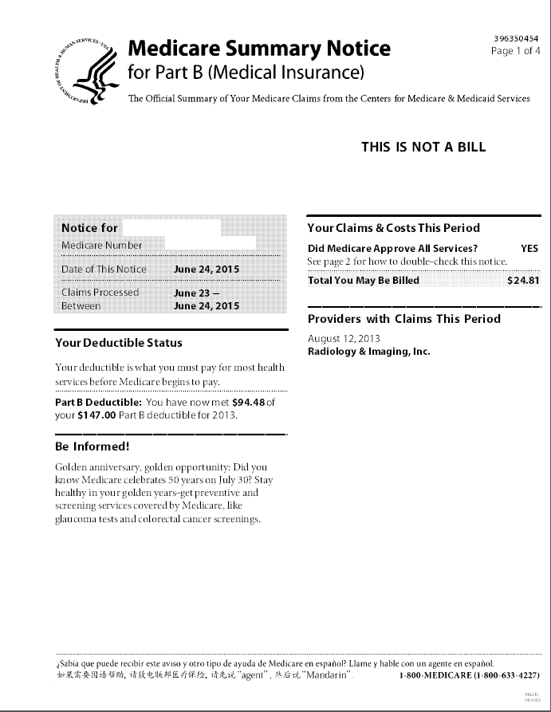
Health Medicare Accessible PDF
ANOC
Directories
EOBs
SBs

Slide 34
Thank You
Notes:
1_title slide

