Slide 1
QA and Testing
Notes:
1_Title Slide

Slide 2
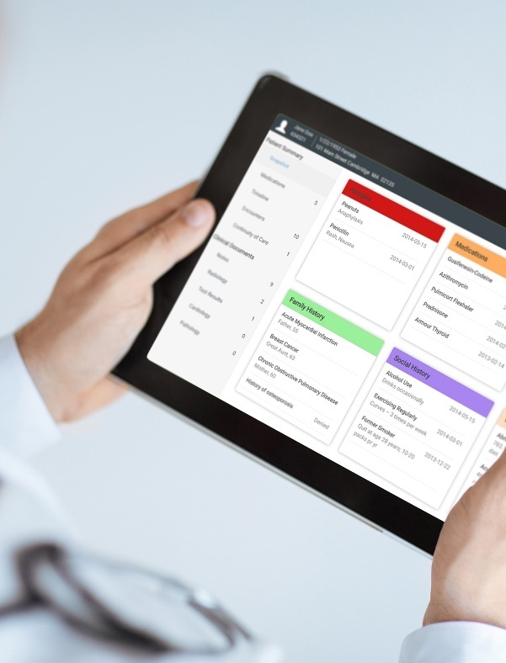
Crawford Technologies
CrawfordTech is a global software company focused on helping enterprises output, digitize and deliver customer communications
Our portfolio and know-how span the intersection of digital output, content management and analytics applications
“The work behind the workflow”
Accessibility
Content Services
Enterprise Output
Software and services provider for accessibility strategies and solutions
Optimizing content distribution strategy and
delivering high-value customer communication archive solutions
Transforming and optimizing workflows for all output processes

Slide 3
Introductions
Katrina Fox Marketing Specialist kfox@crawfordtech.com
Jen Goulden Project & Quality Manager jgoulden@crawfordtech.com
Aimée Ubbink Document Accessibility Specialist aubbink@crawfordtech.com

Slide 4
Alternate Formats QA
Braille
Governing bodies and standards
Certified braille transcribers and proofreaders
Large Print
Industry Standards
Guidelines and best practices
E-Text
Standards
Guidelines and best practices
Audio
Standards
Guidelines and best practices

Slide 5
Standards and Guidelines
WCAG
WCAG 2.0 AA has now become the most prevalent guideline
WCAG 2.1 just released
WCAG, Web Content Accessibility Guidelines
Set up by the W3C – followed by many accessibility guides and laws (AODA, ADA, Section 508)
WCAG Ensures Web Accessibility, Set of standards for websites, Set of guidelines for documents

Slide 6
Standards and Guidelines
PDF/UA
PDF/UA is a standard (ISO 14289-1)
PDF/UA is aimed at Documents
PDF/UA Normative and defined standard for Accessible PDF
PDF/UA Provides standard for developers to configure assistive technology software/devices

Slide 7
Standards and Guidelines
HHS
HHS is based on the refreshed WCAG 2.0 (WCAG 2.1 pending)
HHS has policies, requirements and standards in addition to Section 508
HHS Checklists are the official HHS Accessibility checklists
HHS For any electronic document distributed via email or posted online, internally to the Government or externally must comply with Section 508 guidelines and the checklists

Slide 8
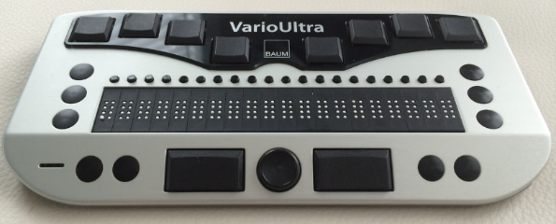
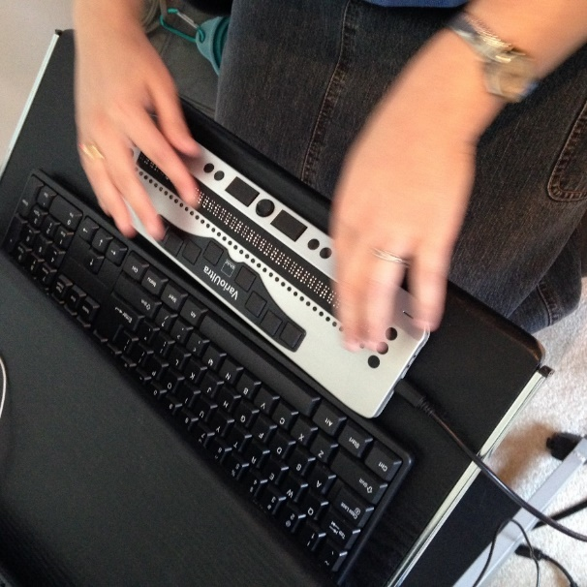
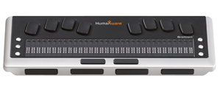
Assistive Technology – Braille Displays
Notes:
Items seen in braille that are not available in the screen reader

Slide 9
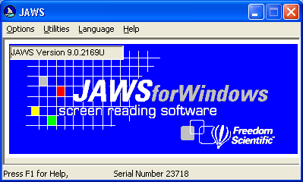
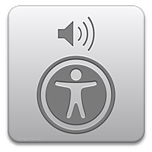
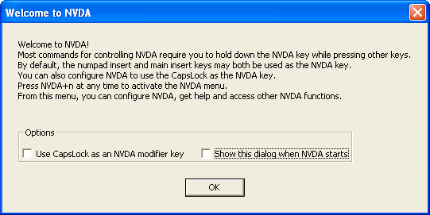
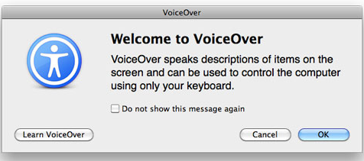
Assistive Technology – Screen Readers
Notes:
Screen reader configuration (verbosity) e.g. table summary (Users don't always maintain the recommended settings)
What it is, products (Jaws, NVDA, VoiceOver, Window Eyes)
What not to use (Adobe Read Aloud)
Do you or do you not force the user experience and why or why not

Slide 10
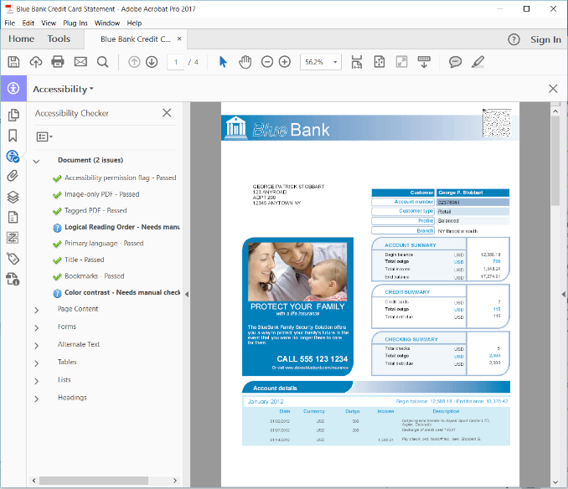
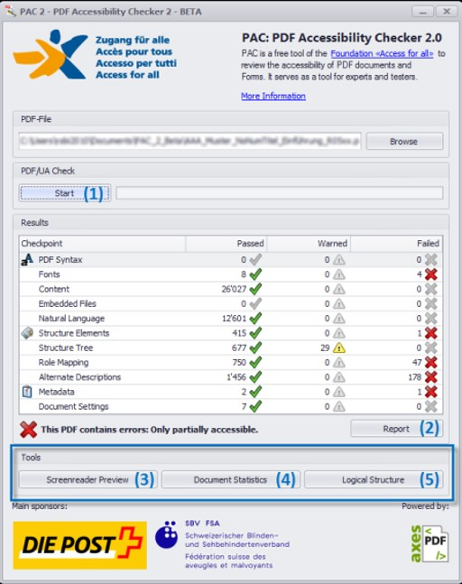
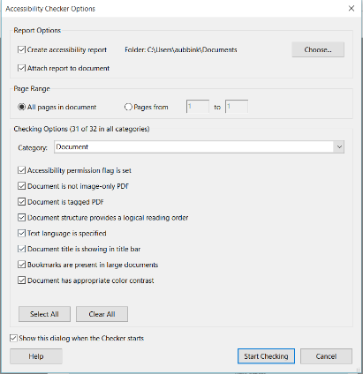
Automated Checkers
Notes:
Tools and limitations
Necessity of manual QA (of tags/read order) and testing with a power-user

Slide 11
Automatic Fails
Notes:
Tools and limitations
Necessity of manual QA (of tags/read order) and testing with a power-user

Slide 12
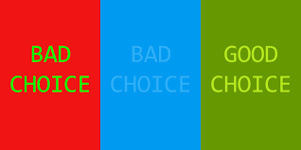
Contrast

Slide 13
Video: Poorly Tagged vs. Properly Tagged Document
Notes:
Video5-PoorlyTaggedVSTaggedWell.mp4

Slide 14
Video: Accessible and Inaccessible PDF
Notes:
Video1-Scanned-AccessiblePDF.mp4

Slide 15
DEMO

Slide 16
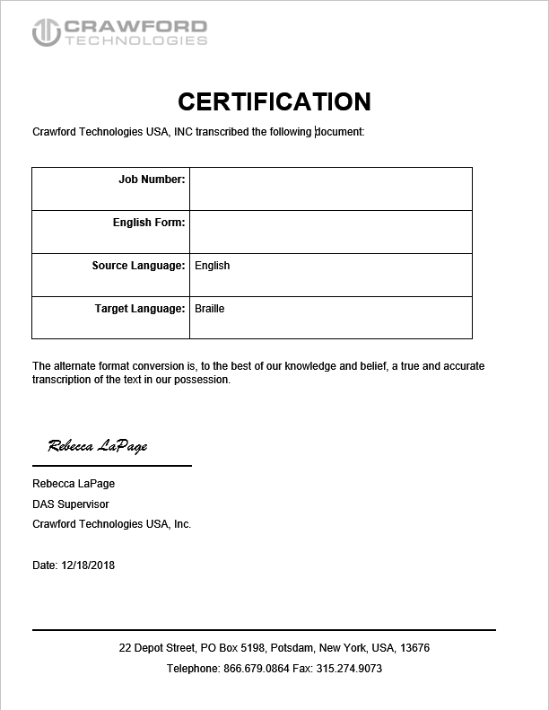
Compliance Certificates
What does Crawford Technologies provide?
Notes:
Tools and limitations
Necessity of manual QA (of tags/read order) and testing with a power-user

Slide 17
QUIZ
Should you involve end users during your testing?

Slide 18
QUIZ
True or False?
I opened the PDF and it read out loud to me, it must be good to go, right?

Slide 19
QUIZ
Why is it important to use both human and electronic testing?

Slide 20
QUIZ
Which is not a checker?
PAC 3.0
Acrobat Pro
Jaws

Slide 21
QUIZ
I tested with Adobe Read aloud, why isn’t this good enough?

Slide 22
QUIZ
Why should I test with a braille display or multiple screen readers (NVDA, JAWS, VoiceOver)?

Slide 23
QUIZ
Are there guidelines or best practices that I need to follow for large print?

Slide 24
QUIZ
Is there such a thing such as 508 certification?

Slide 25
QUIZ
Do all screen readers relay content the same way?

Slide 26
Thank You

Slide 27
Questions
Should you involve end users during your testing?
True or False? I opened the PDF and it read out loud to me, it must be good to go, right?
Why is it important to use both human and electronic testing?
Which is not a checker?
PAC 3.0
Acrobat Pro
Jaws
I tested with Adobe Read aloud, why isn’t this good enough?
Why should I test with a braille display or multiple screen readers (NVDA, JAWS, Voice)?
Do all screen readers relay content the same way?
Are there guidelines or best practices that I need to follow for large print?
Is there such a thing such as 508 certification?

