Slide 1





Crawford Technologies
Optimizing PDF Files

Slide 2


Meet us
Katrina Fox
Marketing Specialist
Crawford Technologies Inc.
Ernie Crawford
CEO/President
Crawford Technologies Inc.
Notes:
Thanks for allowing me to chat with you about accessible documents today

Slide 3
Introducing the CrawfordTech family
Enterprise Output Management
Content Services
Document Accessibility Solutions
Professional Services for ECM/capture
Data Archiving
Application Decommissioning
Government & Education focused solutions
Web & Document Accessibility
Self-serve portal
Fast cost-effective document accessibility

Slide 4
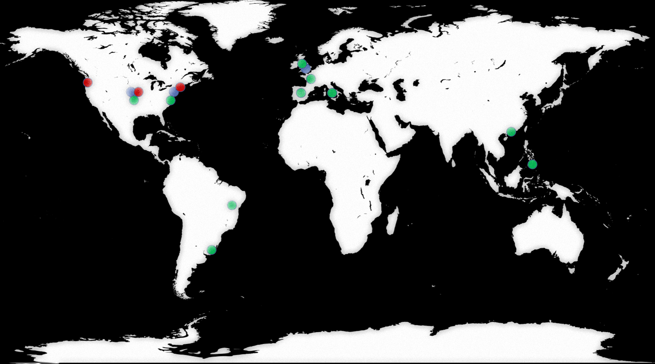
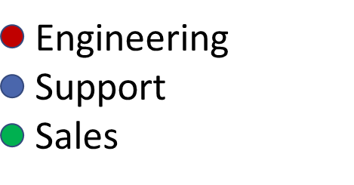
CrawfordTech Footprint
Group of companies with over 140 employees
Organic debt-free double-digit growth
1,800 Customers on 6 continents
  7 out of the top 10 banks in America
  17 out of top 20 insurance companies
  The 3 largest healthcare payers in the U.S.
  Print Services Providers of all sizes worldwide
Notes:
We started in my basement in 1995, but we are now a group of multiple companies with over 125 employees, growing at 30 20+%/year
With offices in Toronto, Brampton, NY, Boulder, Fort Collins and London
Customers on 6 continents and blue chip partners all over the globe
With all the changes in the market, customer expectations and technology, you need a strong vendor to help you through uncharted waters. We are that vendor.

Slide 5
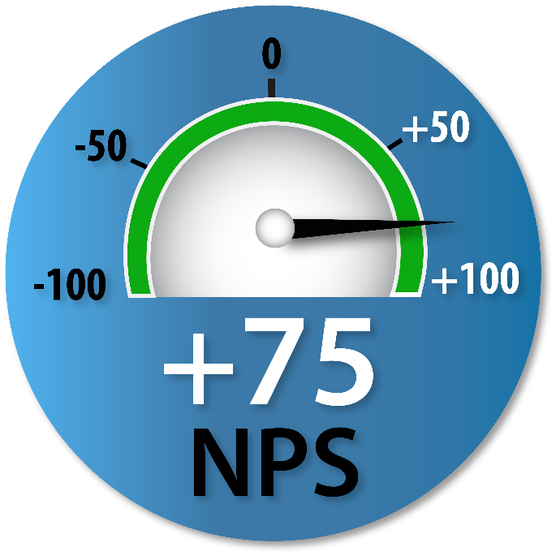



















Award Winning Crawford Technologies
2008
EMC World 2015 Partner Innovation Award for InfoArchive Solution
Best of Show 2009
Honorable Mention

Slide 6
The Future of Customer Communications Delivery
Print Center Management Workflow optimization and automation
eDeliveryNow Modern eDelivery platform
AccessibilityNow Complete document accessibility platform
Content Services Combining Archiving and ECM with eDelivery
Quality Assurance Document quality control solutions
Security Document security solutions

Slide 7
CrawfordTech PDF History
1996 Built PDF creation library
2003 Built PDF Merge functionality
2007 CrawfordTech joins PDF Association
2007 Built PDF/A creation capability
2009 Built PDF Interpreter
2011 Built PDF Normalizer with optimization capabilities
2013 Built PDF/UA creation capability
2016 Added WCAG 2.0 Accessible PDF creation capability
2017 Built Automatic Accessibility Tagging software for PDF
2019 Launched AccessibilityNow platform

Slide 8
PDF Optimization Areas
Processing Performance
Printing Performance
Storage size
Print Quality
eDelivery
Accessibility (WCAG and PDF/UA)

Slide 9
PDF Problem Causes
Mismatched creation
Poor creation software (but it was cheap!)
Storage costs
Repurposing
Standards compliance (i.e. PDF/A)
Poor concatenation of PDF files
Vendor confusion

Slide 10
Vendor Confusion
Exactly what is optimization?
FreeFlow Advanced Prepress module—Provides powerful tools for PDF optimization, color management, document manipulation and annotation. This module helps you speed through a wide range of file optimization actions, including adding barcodes, pressmarks, text and images to documents.

Slide 11
PDF Performance Issue Causes
PDF Page Tree Structure Imbalances
Fonts
  Duplicated fonts
Images
  Higher resolution than needed
  Multiple images and multiple layers create complexity
  Duplicated images and graphics
Graphics
  Complex and duplicated graphics
Poor Concatenation
Printer-based optimizations

Slide 12
Printing and Processing Performance
Biggest challenge for many shops
High speed inkjet compounds the impact of poor performance for RIP and Processing performance problems
Why is it hard to resolve?
Most steps involve same PDF processing software as your RIP uses
Therefore most optimization software takes as long to run as your RIP

Slide 13
Breaking the PDF Optimization Logjam
Need software designed from ground up for optimization
Cannot use Adobe library or Jaws interpreter
  These are used in most RIPs and processing software

Slide 14
PDF Optimization Case Study
Had daily PDF streams that took 40 hours to process
Were adding servers to try to solve the problem
CrawfordTech PDF Normalization solved the problems
One 7 hour job reduced to 20 minutes

Slide 15
PDF Storage Size Issue Causes
Lack of compression
Unnecessary objects should be deleted
Use common color (RGB, CMYK or grayscale)
Fonts
High resolution images
  May be downsampled
Embedded videos
Poorly concatenated PDF files
PDF/A usage includes Base-14 fonts in PDF
  Guarantees display and print quality but increases PDF size

Slide 16
PDF Concatenation Issues
Individual PDF files with fonts optimized using font subsetting
All fonts duplicated in concatenated files
i.e. 5*1,000 = 5,000 fonts in resulting PDF
  Address this issue with intelligent font combining
  Reduces fonts in concatenated file significantly
Duplicated forms, graphics and images

Slide 17
CrawfordTech Solutions
PRO PDF Interpreter optimized for performance
PDF Driver creates PDF optimized for both performance and size
PRO Concatenator uses intelligent resource management techniques to create optimized PDF files
PDF Normalizer converts poor performing PDF files into streamline PDF
  Reduces overall processing time significantly

Slide 18
Print Quality
Mismatched image resolution
  i.e. 200 dpi images on 300 dpi printer
Printer-based optimizations
Type 3 fonts with mismatched resolution
Printer-specific optimizations
Poor use of transparency
Mismatch of color spaces
Match printer colors i.e. CMYK using color management and proper ICC Profiles

Slide 19
eDelivery
Processing and size both need optimization
Linearization (optimization)
  Lets first page display while file is being downloaded
High resolution images
Type 3 font usage can cause stairstepping on screens
PDF/A usage includes Base-14 fonts in PDF
  Guarantees display and print quality but increases PDF size
Use RGB colors

Slide 20
Accessibilty
PDF files need to be properly structured for accessibility compliance
  S508, ADA, AODA, ACA, EN 301:549
PDF files need to be PDF/UA or WCAG compliant
  Elements on page need to be tagged with intent
  Graphics need alternate text descriptions
  Reading order needs to be specified

Slide 21



AccessibilityNow Publisher
On premises server-based solution for static documents
Can be automated like a drop box
Eliminates high percentage of manual remediation/tagging via artificial intelligence
Requires some manual quality assurance
Reduces turnaround from days to minutes
Significantly reduces costs for remediation
Or
Files your system generates
Document Transform Process and AccessibilityNow Publisher
21

Slide 22
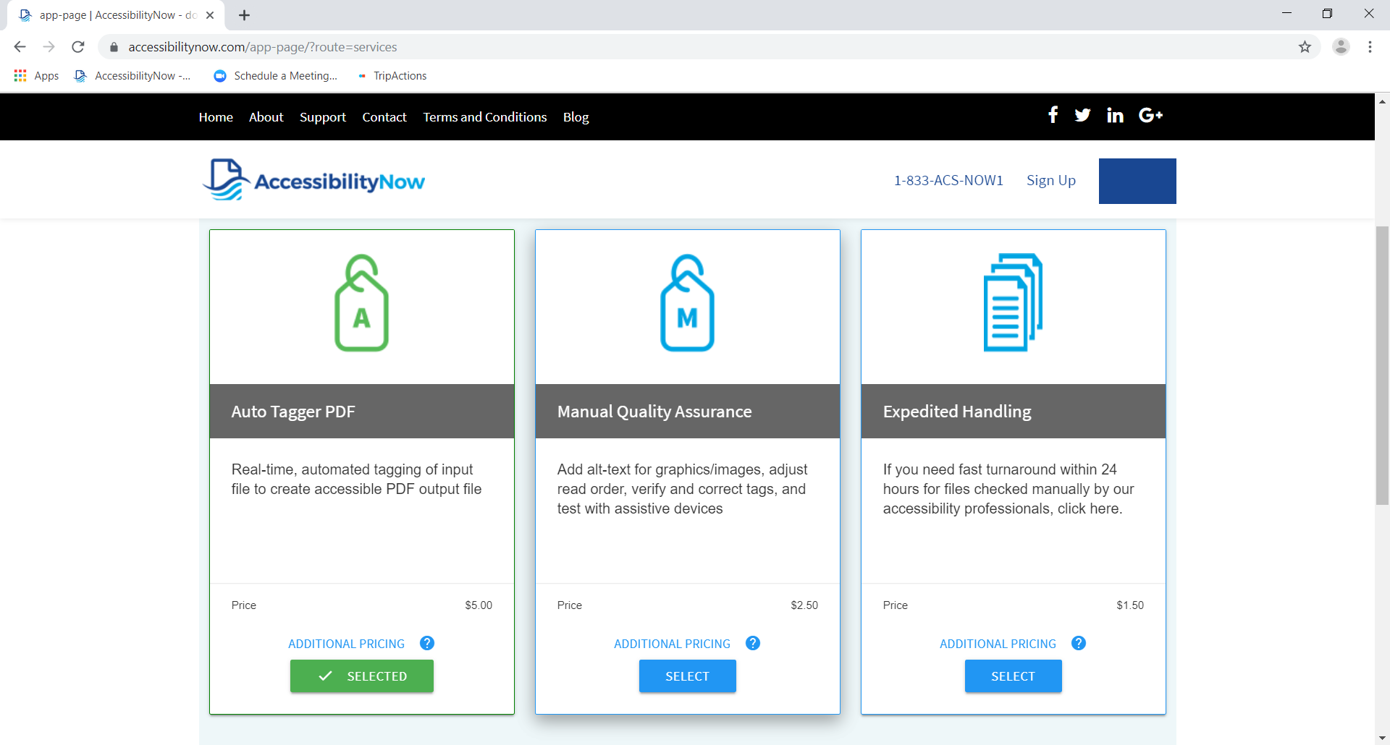
22

Slide 23
Things Not To Do In PDF FIles
Proprietary objects in PDF
Use comments for data
Use rolling codepoints
Use All-In-One fonts

Slide 24


Learn More
Find us on Facebook, LinkedIn, Twitter and Google+
Visit: www.crawfordtech.com or
e-mail: sales@crawfordtech.com
Phone: 1-866-679-0864

