Slide 1
CSUN 2020 Presentation The democratization of Accessibility: SMB Compliance

Slide 2
What We’ll Cover Today
State of Play 2020 from SMB Perspective
How they Select a Target for Litigation
Prevailing SMB Questions re: Accessibility and Compliance
What SMBs Want vs. What they Need
Our Answer – What’s Really Required to Insulate a Business
The Best First Step
Is it really worth it? The Business Case for Accessibility Compliance

Slide 3
State of Play: ADA Compliance Litigation
Demand Letters and Lawsuits continue at a torrid pace
“Click-by” litigation
No SMB is Immune
No End in Sight – 30% chance to be sued again
Unfortunately, Ignorance is not an excuse
Recent Examples Include: Food service, eCommerce, retail stores, car dealerships, wineries, galleries, hotel/hospitality industry, entertainment industry and local governments

Slide 4
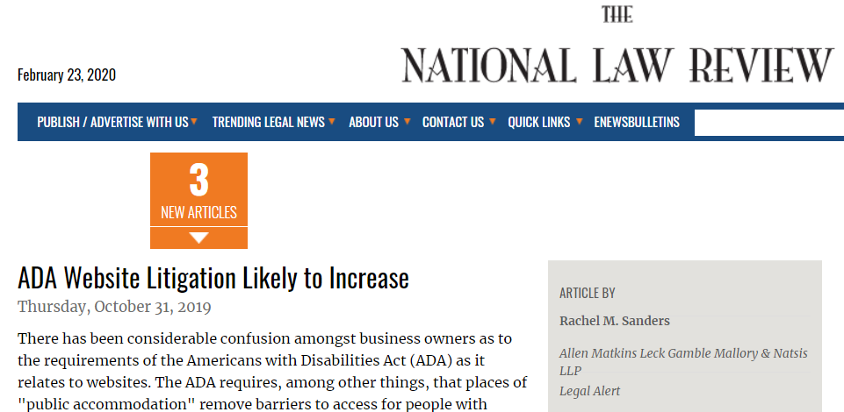
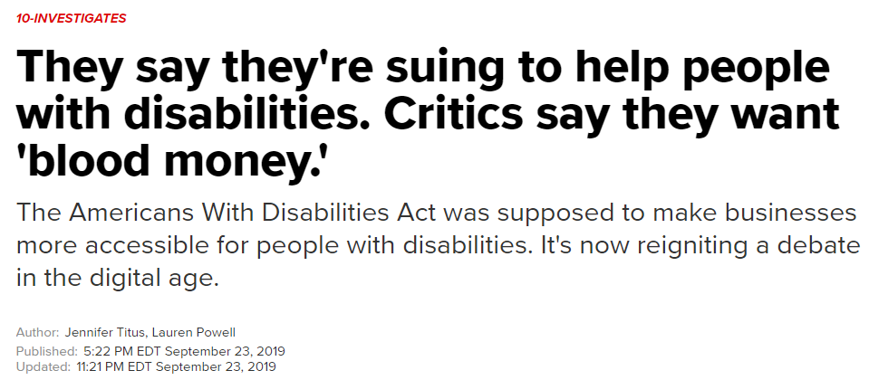
State of Play: ADA Non-Compliance Litigation

Slide 5
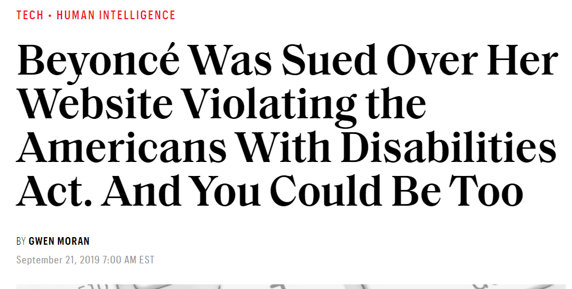
State of Play

Slide 6
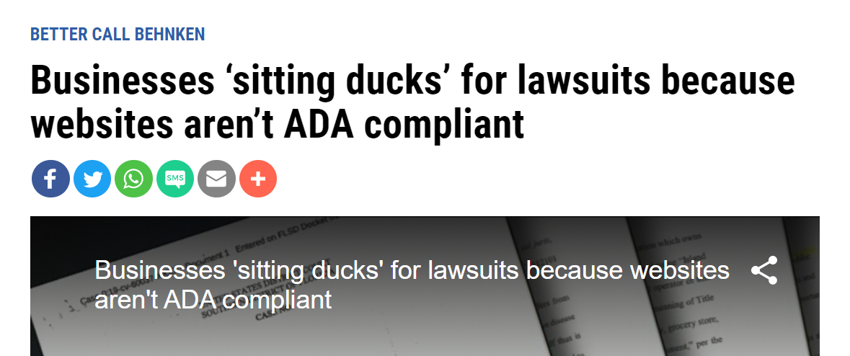
State of Play: Continued

Slide 7
How Do Serial Litigants Target?
It’s actually quite simple:
Tools are readily available to easily scan multiple sites
Document scanning tools also available
It’s not too hard to figure out if a check out page works properly
Many business owners are not aware this is happening.
Unfortunately, ignorance is no longer an excuse.

Slide 8
What we hear from business owners…
Even if the owner is aware…. Where do they even start?
We know big business has the resources to enable accessibility both proactively and reactively
For SMBs though, confusion reigns, overwhelming and inconsistent information
Constantly fielding inbound sales calls to buy point solutions – software
In-house or outsourced?
Big questions remain on cost, true ROI and risk mitigation

Slide 9
What business owners want vs. What they Need
What SMB owners want and what they need are not mutually exclusive.
Here’s what we’re hearing:
Clarity, simplification and clear guidance
They want the problem (and the risk) to just go away
They don’t want point solutions that leave gaps in their compliance
They want to know what to do first….
They wonder if it is worth the hassle, ROI and will it work…
Costs – outcome must be clear and no open-ended engagements
Our Approach:
Simplify, Provide Options and Access to Solutions

Slide 10
Components of Holistic ADA Compliance
Considerations for Digital Compliance program – Options for any organization but within reach for Small and Medium Businesses (local governments too):
Website Compliance Software – End User Menu, Audit, Remediation, Monitoring and Reporting
Manual Website Audit
Accessibility Policy, Statement and Checklist
Organizational ADA Compliance Planning
Dedicated Training Portal: Web, Document, Policy, WCAG Standards Certified Experts
Done-for-You Web Compliance Services
Captioning and Transcription Services
Desktop Document Remediation Software
Document Remediation, Scanning and Health Check
Alt. Formats Available: Braille, HTML5, Text-Audio, Accessible PDF
All Inclusive Digital ADA Compliance Program Support

Slide 11
Options = Democratization
We tailor solutions for individual customers according to their specific requirements.
A La Carte
Bundled solutions
Organization Program Level approach

Slide 12
What Not to Do
Because many SMBs may be just getting started on accessibility, here are some things to avoid:
Thinking it’s “one and done” - Websites and other digital content change all the time
Accessibility is a journey, not a point-in-time event
Assume you’re covered by that software you bought last month
Assume your hosting vendor has it all covered
Assume something negative can’t happen to you….
Assume that accessible means usable
Assume that help is out of reach due to cost and complexity

Slide 13
Ok, all that’s great but where do we start?
At a bare minimum, the one thing we recommend is running an assessment and developing a plan:
Identifies where vulnerability gaps exist with website, documents and Policies
The plan will very specifically state how you will close these gaps, on what timeline and with which resources
Will help prioritize next steps
Provide a basic budget for getting and staying compliant

Slide 14
OK, but……
All this seems like a lot of work…..
Is it really worth it?

Slide 15
Yes, and here’s why…
The Business Case for Accessibility
OR
The True ROI of Digital Accessibility Compliance
Risk Mitigation
Lower Operating Costs
Tap Huge Underserved Market
Build Brand Equity
Increased Revenue
and/or
Cost Savings

Slide 16
Reason #1: Risk Mitigation
We started by talking about the reality of potential legal complications for non-compliance. Here’s a recap:
Serial litigants are scouring the internet looking for weaknesses
If they find a site they can properly navigate, has alt text for images/graphics, can complete a transaction, consume a digital document, has an accessibility statement prominently posted…..
They will move on to the next potential target
Ultimately saving you the costs and headaches of legal fees, lost time, settlement costs, court costs – all before even the costs of fixing the deficient website.
Proactive and holistic accessibility compliance can help insulate from serial litigation, saving you SERIOUS money

Slide 17
Reason #2: Lower Operating Costs
It can cost up to 100X more to fix non-compliant issues than to design and build compliant digital assets to begin with:
How many inbound complaints?
Cost of remediation – one complaint at a time
Blind customers report weekly help desk complaints
What costs more to generate? Online transaction or walk in, call in?
Assuming 15% potential customers are disabled, what is the ROI
Consider the lifetime value of any customer

Slide 18
Reason #3: Tap Huge Underserved Market
It’s estimated the working age disabled buying power in the US is $490 Billion.
If they can’t transact on your website, it’s a problem
They will go to your competitors
Recent article states 70% of websites had some critical issue preventing completion of transaction
Not just one transaction, consider lifetime customer value

Slide 19
Reason #4: Build great brand equity
Buyers requiring accessibility talk with each other, their friends and family – They are Influencers
Digital equity is a critical factor in brand image and social perception
Being an accessible brand has both tangible (ROI) and intangible benefits
More people than ever consider brand values when considering a purchase
Bottom line: This is another factor in accessibility ROI

Slide 20
Final Thoughts
Is it worth it?
Yes, the ROI is Clear
Can We Afford it?
Yes, our tailored solutions can help any SMB achieve immediate results

Slide 21
Questions?
Questions?
Thank You
Matt Hempel
Matt@AgilitechSolutions.com
919.421.7300

