Slide 1
Document Accessibility
Infrastructure to Avoid Litigation
Accessible Document Solutions for the Future

Slide 2
What you will learn
Legal and why
What my organization needs to be aware of
What can we do
How to be proactive

Slide 3

Barriers
Notes:
Paper is a barrier, Reading it to them
What are the formats? Don’t know how to respond to the situation
Client is now having to explain what they need and why

Slide 4
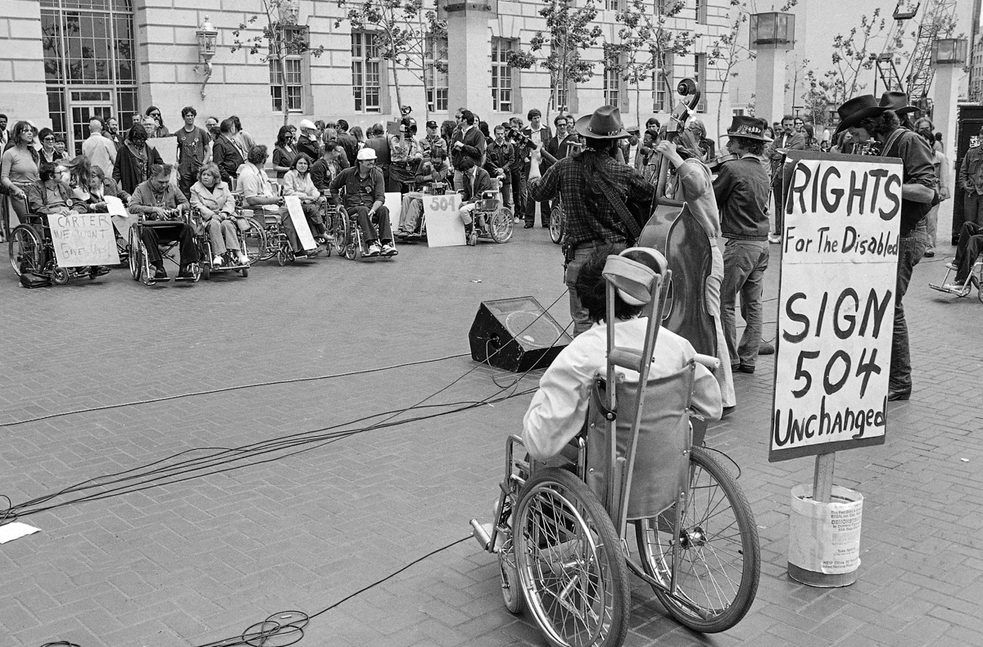
Rights for the Disabled

Slide 5
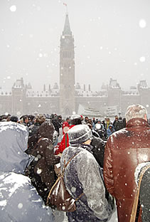
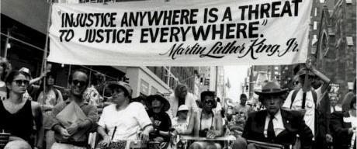
Disability Rights Activism

Slide 6
With the Recent String of Legal Activity
Demand Letters
Lawsuits
“Legal Extortion”
  People making a career of litigation / settlements

Slide 7

US Regulations
American Disabilities Act (ADA) - Anti-Discrimination Law – Title III/II
Section 508 RULE for doing business with the US GOV
Federal Employment (501/503)
Federally funded - 504
Affordable Heath Care Act (1557) Health IT
Food and Drug Safety Innovation Act (904)
Telecom Act Section 255
Air Carrier Access Act Airline accessibility DOT rule Title 14 CFR Par 32

Slide 8

Canadian Regulations
Bill C-81 – Accessible Canada Act
AODA - Accessibilities for Ontarians with Disabilities
AMA - Accessibility for Manitobans Act
The Act – Nova Scotia
Canadian Human Rights Act 1977
Charter of Rights and Freedoms 1982
Omnibus C78

Slide 9
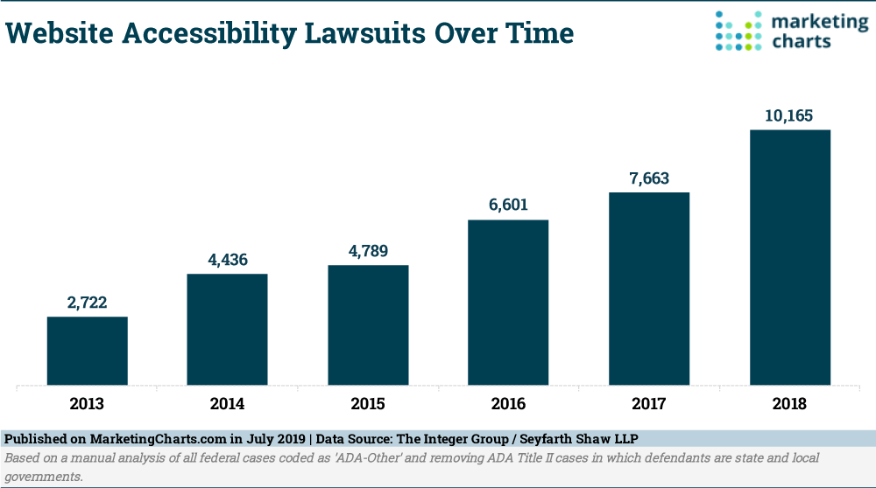
Website Accessibility Law tsuits Over Time

Slide 10
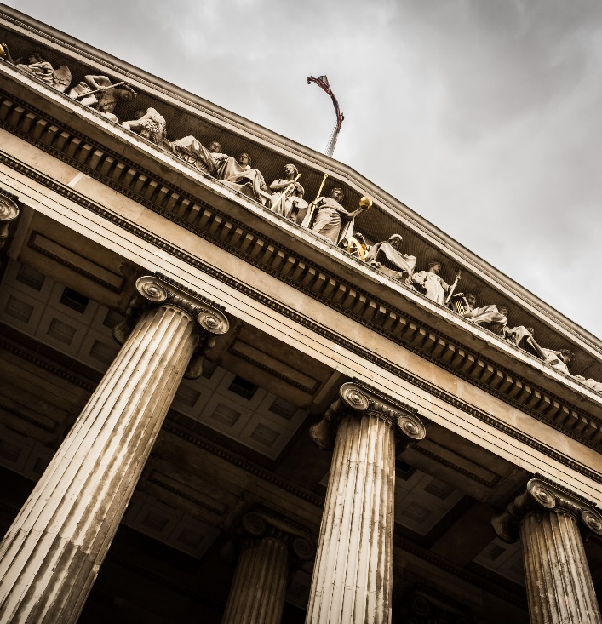
Legal Settlements / Fines - USA
State of Florida
Winn Dixie – over $250K plus legal fees
Verizon - $20 million
Amex – structured settlement
Wells Fargo - $16 million
Target - $6 million
Harvard / MIT – multiple rulings –
$2 million plus
Student Financing – All Student loans must provide
accessible documents
Elections
Hotels
Banks – NY Banks
Notes:
Photo by Sebastian Pichler on Unsplash

Slide 11

CRPD
UN Convention on the Rights of Persons with Disabilities
  International law
  Canada ratified in March 2010

Slide 12
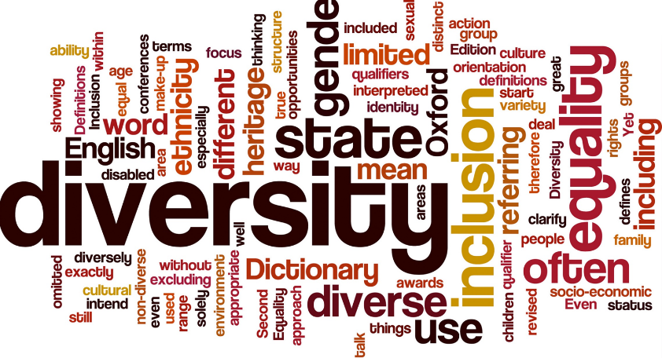
Accessibility Goals
Goals
  Be in compliance with evolving regulations on delivering accessible documents to blind, partially sighted and cognitively disabled individuals
  Meet the inclusive needs and requests of a large and growing population
  Automate and scale the creation of accessible documents in all formats

Slide 13
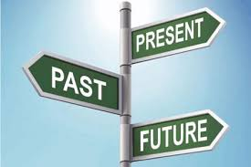
State of Accessible Documents
My documents are not compliant
High volume documents cannot be done – too costly with current technology – we are manually remediating
I’m ignoring the issue
My documents are compliant – I’ve got a solution
Notes:
So where are your documents today? Do you produce high volume documents? Do you present on the web? Generally we can bucket everything into four buckets “I’m ignoring the issue”, “My documents are not compliant”, “High Volume documents cannot be done so we are remediating or accommodating”. “My documents are compliant and we have a solution”

Slide 14
Problem with Documents
No accessibility tags or accessibility
Many documents stored as scanned images
Formatting is poor
  Missing headers
  Information on images
  Garbage in makes accessibility tough

Slide 15

The Challenge
Making content, educational content, published content, personal and confidential information accessible quickly and easily
Don’t forget your internal HR employees
Providing anyone the ability to make content accessible
Training
Automating
QA & QC
Minimum compliance WCAG 2.0,
WCAG 2.1 soon – lawsuits have started already

Slide 16
Plan
Create a Culture of Inclusion (Accessibility)
  Inclusion by design
  Should not be an after thought
  10X the cost to retrofit – based on dev system background

Slide 17
Critical Organizational Requirements
Build everything with accessibility in mind – good for all
  Consider automatic opening doors
  Curb ramps
Budget for accessibility

Slide 18
Success
Template creation –
  Its hard to train everyone
  Start with corporate templates – MS Work / Powerpoint
  Train the use of these templates

Slide 19
Things to implement
Training – train users on remediation and tagging in common office tools and new generating remediation tools. Understand testing
Remediation for back log – set up a plan
Web monitoring – on-going audits
Document Monitoring - on-going audits
High volume correspondence - plan
Preference Management – Alternate formats – braille, large print
QA & QC

Slide 20
What else?
Website accessibility – Web & Mobile
  Video captioning
  Alternate text for maps and graphics
  Note WCAG 2.1
PDFs on the website
  Forms & Documents
Mobile App lawsuits rising
Portals for transaction billing & notification – Tax and Utilities
AODA accommodations – requests – braille, large print

Slide 21

Prepare for Document Accommodations
Service Providers must provide accommodations
Banks, Telecom
Request Accommodations
Request Digital Accessible Documents

Slide 22

Braille

Slide 23
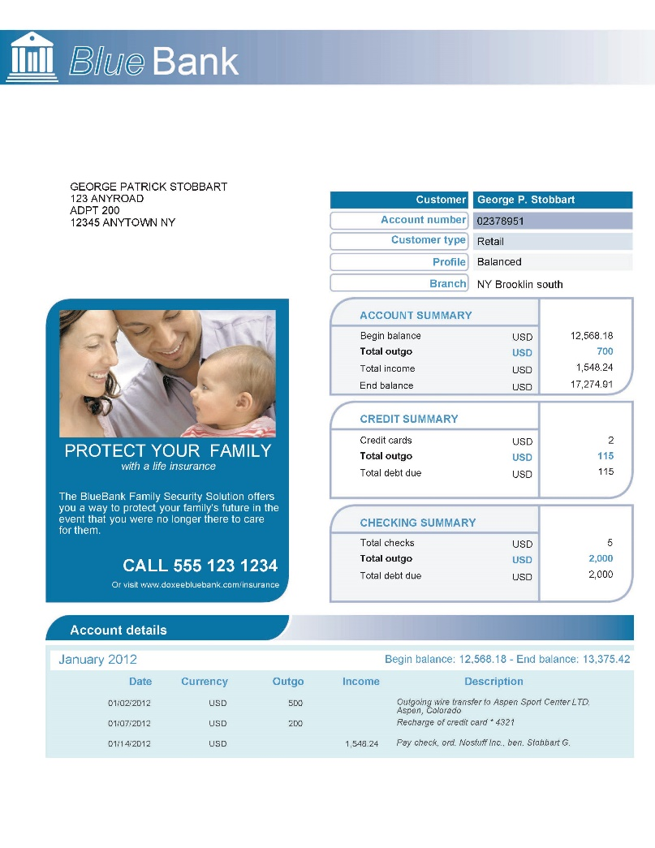
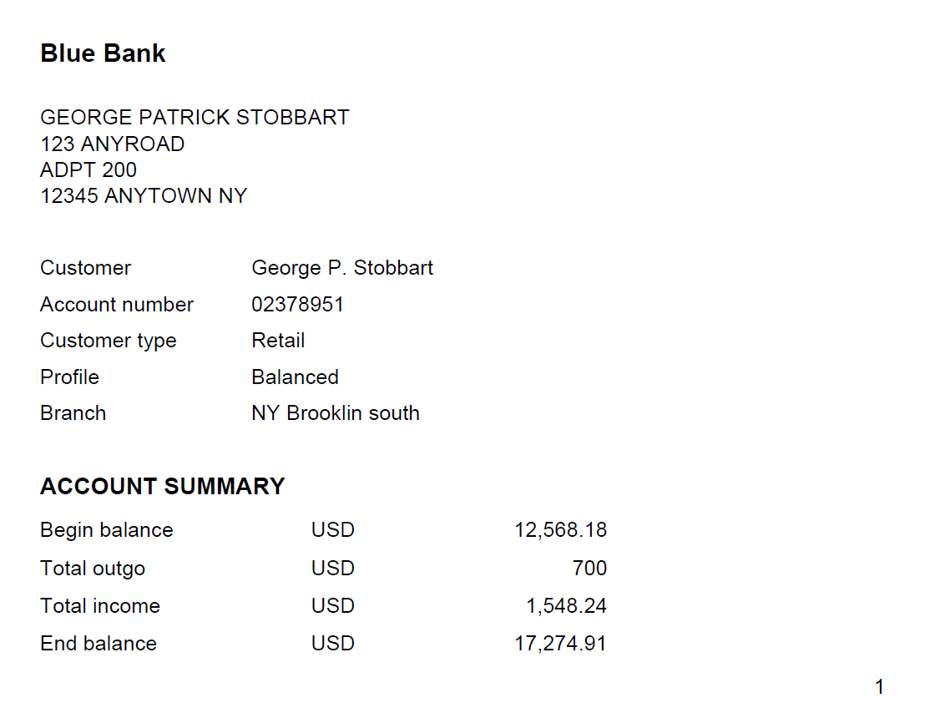
Large Print

Slide 24

Audio

Slide 25

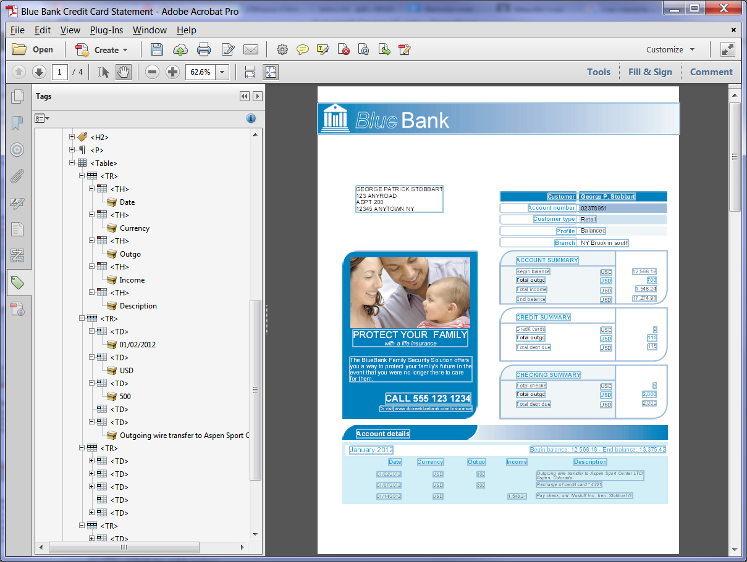
ACCESSIBLE PDF
Accessible

Slide 26

HTML 5 Accessible
Accessible

Slide 27

The Solution – Apply Technology
Awareness of Accessibility, document accessibility is growing considerable
Scalable solutions are now available
Application technology for easy access

Slide 28
Digital Solutions
Assistive Technologies
  JAWS
  NVDA
  Others

Slide 29

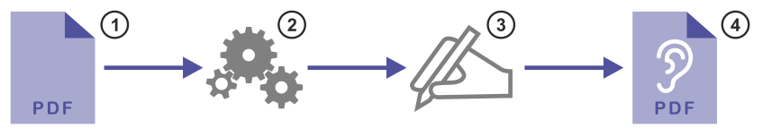
Automation to Accessible Digital Formats
Hundred of pages per second to Hundreds per minute

Slide 30
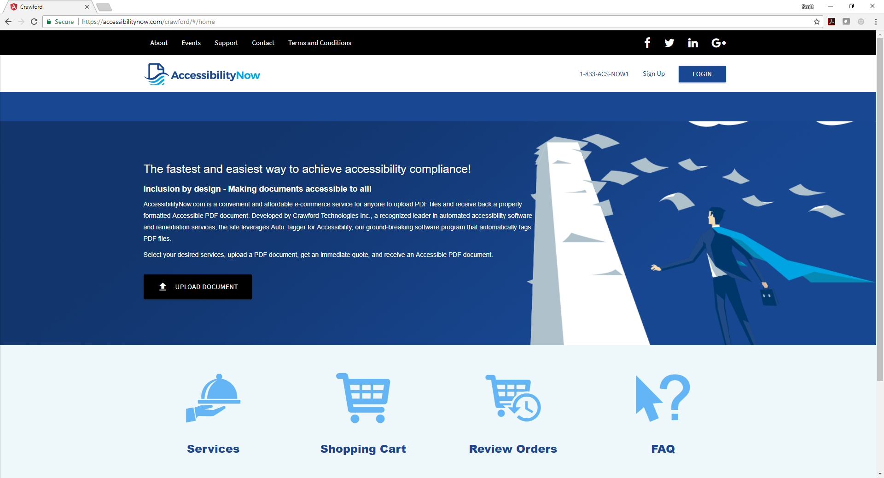
AccessibilityNow Website

Slide 31


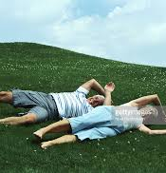
Pitfalls – ALT Text

Slide 32
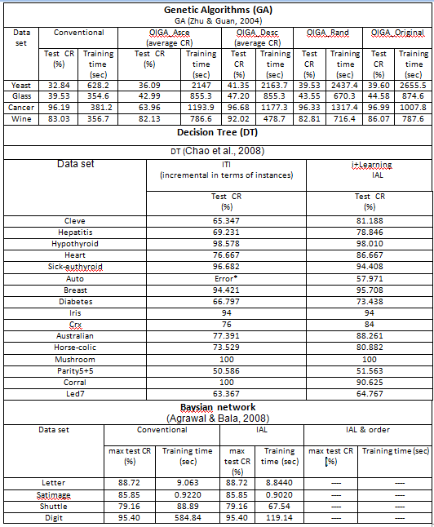
Complex Tables

Slide 33

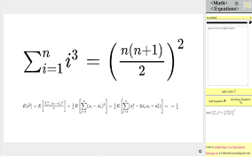
Mathematical / Symbology

Slide 34
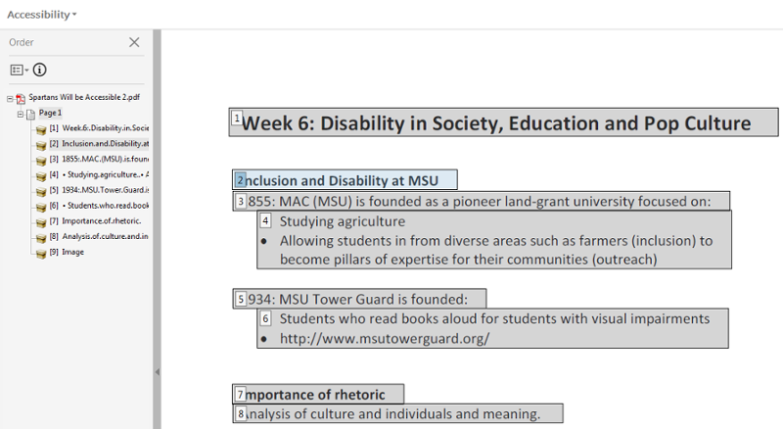
Read Order

Slide 35
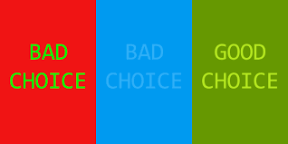
Contrast

Slide 36
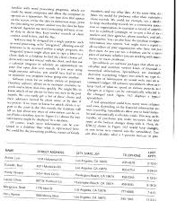
Scanned Text

Slide 37
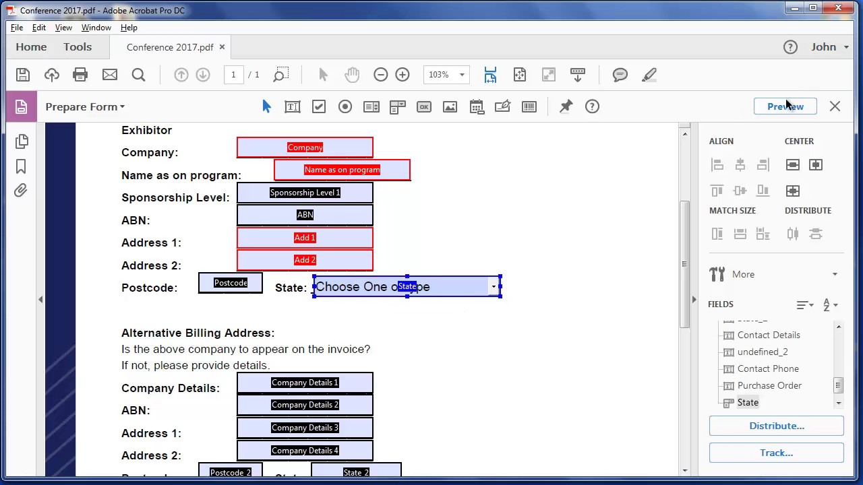
Fillable Forms
Hours of remediation
Very expensive

Slide 38
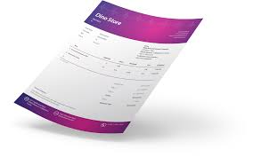
Template Remediation – High Volume Docs
Visa / Mastercard
Telecom bills
Tax bills
Water bills

Slide 39
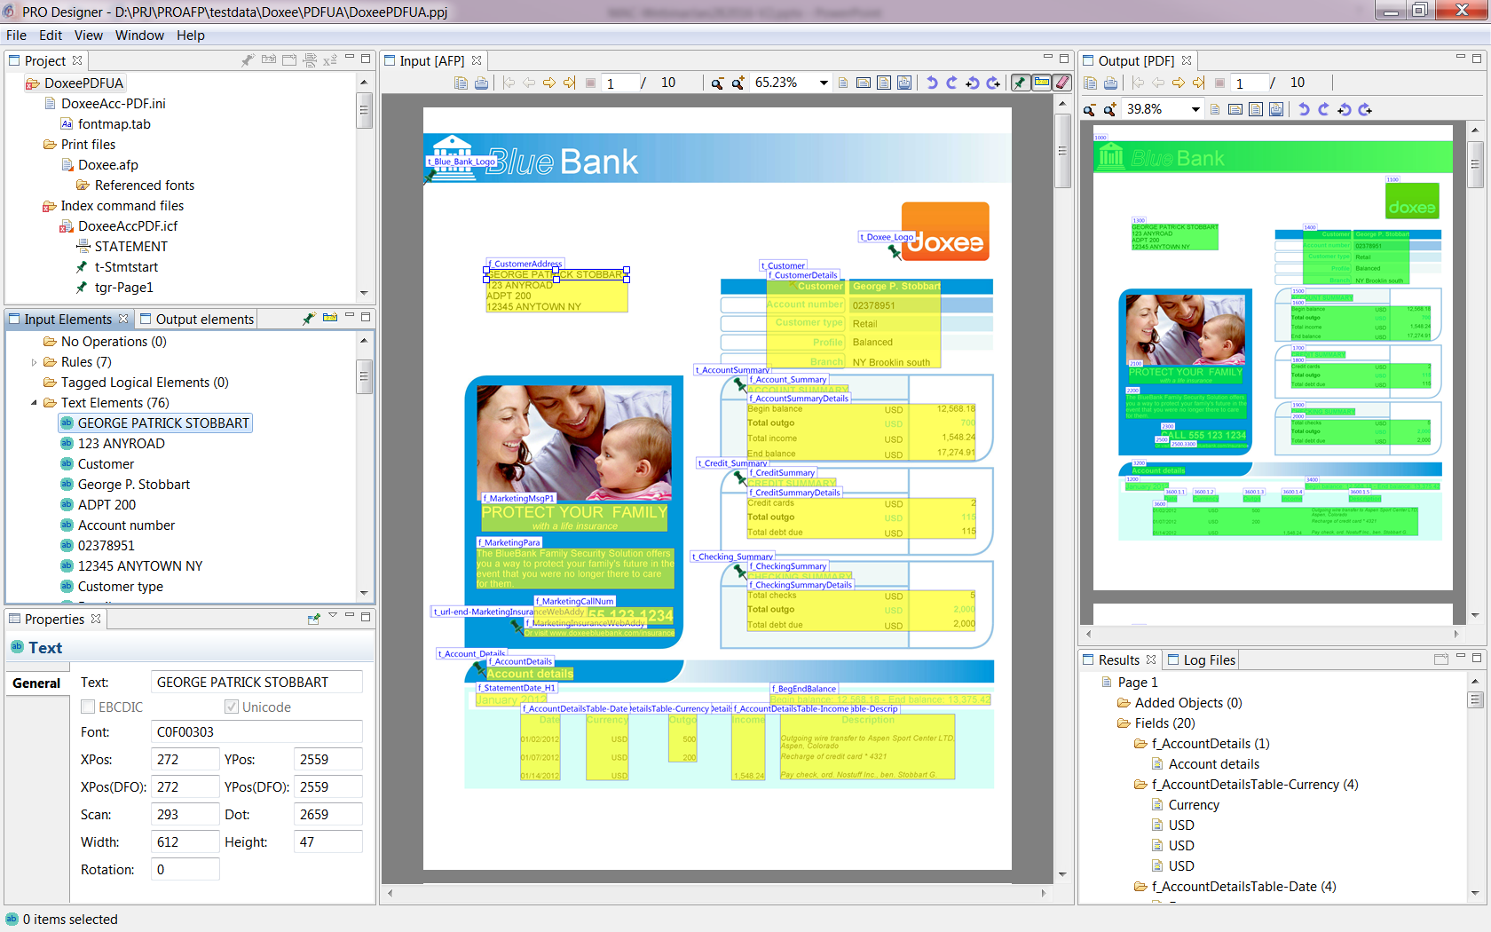
PRO Designer Screen Shot
PTOCA
Presentation Tex Object Content Architecture

Slide 40
Testing – Quality Assurance / Control
Make sure you test your documents/web to be accessible
  Conduent is under a huge lawsuit for making The State of California Parks reservation system. Whistle blowers determined that the website was not accessible despite claims for full accessibility.
Don’t leave accessibility testing to the end
Assistive technology
Electronic testing – PAC 3.0, Adobe Acrobat PRO
Physical user testing – using Assistive Technologies
USEABILITY VS ACCESSIBILITY

Slide 41




















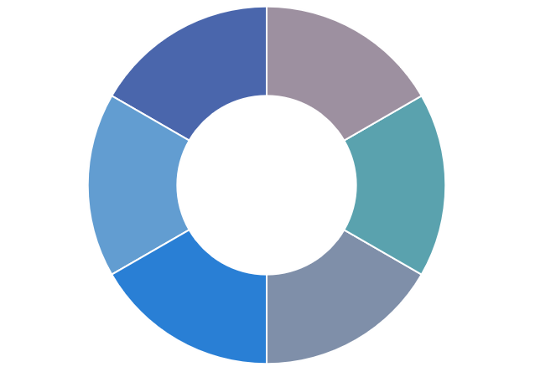
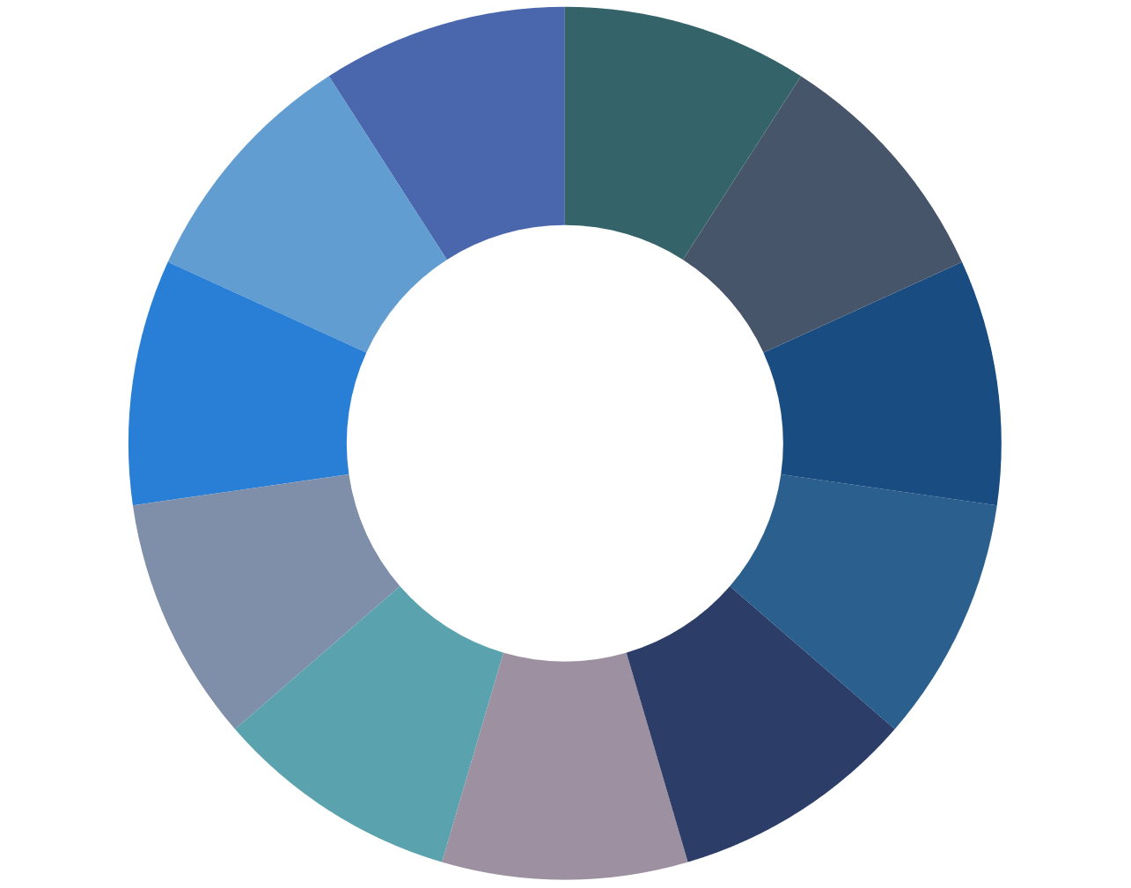
Achieve Accessibility Goals
Transactional
Achieve Accessibility Goals
Comply with global regulations
  Mitigate risk
  Mitigate cost
  Support all formats
Meet customers’ A11y needs
  Over 1.3 billion people globally
  Right format, channel
  Improve CX
Timely and relevant
  Automated
  On demand
Static

Slide 42

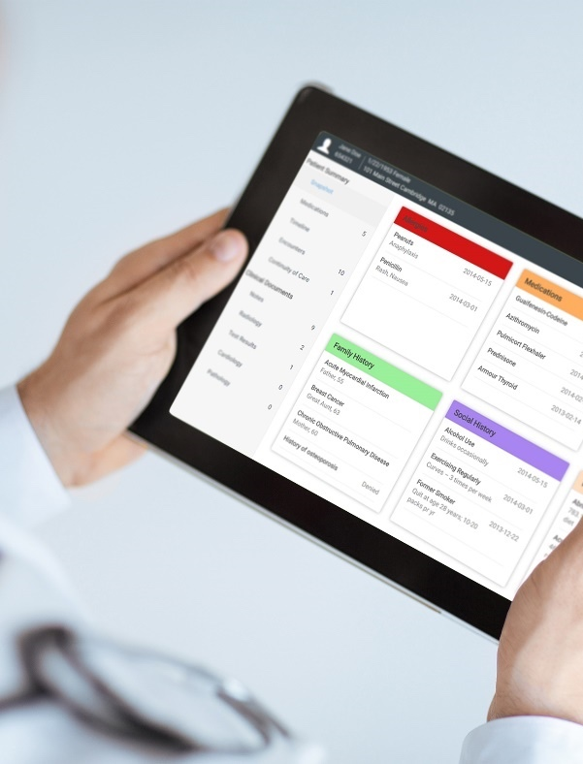

Crawford Technologies
CrawfordTech is a global software company focused on helping enterprises output, digitize and deliver customer communications
Our portfolio and know-how span
the intersection of digital output, content
management and analytics applications
“The work behind the workflow”
Accessibility
Content Services
Enterprise Output
Software and services provider for accessibility strategies and solutions
Optimizing content distribution strategy and
delivering high-value customer communication archive solutions
Transforming and optimizing workflows for all output processes

Slide 43

Learn More
Find us on Facebook, LinkedIn, Twitter and Google+
Visit: www.crawfordtech.com or
e-mail: dquon@crawfordtech.com
Phone: 647-928-9008

