Slide 1
E-Commerce for Document Accessibility
CSUN 2020
Scott Baker, EVP, Crawford Technologies Inc
sbaker@crawfordtech.com
Notes:
1_Title Slide

Slide 2

Scott Baker
EVP
Scott has 30+ years of leadership and senior management experience in the electronic document industry. Scott’s focus at CrawfordTech is on business development, accessibility, and growth strategy.
Scott is a recognized subject matter expert in CCM, ECM, BI, and SaaS. He is a frequent speaker at industry events and webinars.
Booth 515

Slide 3

Where are we, really ? Organizations & Accessibility:
Continues to be outside of mainstream requirements for many organizations
Accessibility is “on our radar”
Compliance is responsible for accessibility
We have not been sued yet…

Slide 4
Enterprise Document Accessibility Challenges
Creating Accessible PDFs
  Never fast and no “easy” button
Accessibility training for all website / document's authors
Ensuring compliance, now and in the future
Timely turnaround
Exception handling is costly and error prone
Scalability
  How is growth in accessible documents volumes funded?
  Managing processing during peak volume periods

Slide 5
Specific Barriers to Making Documents Accessible?
Too many documents and too little time to remediate them
  Tagging is not automated
Costs are high
  Tools are expensive
  Labor is costly
  Training is costly
  Outsourcing on a per page basis is very expensive
Remediation requires specialized knowledge
  To remediate
  To deliver
Understanding what is required

Slide 6
Practical considerations
Are you going to train everyone in accessibility authoring?
How do you deal with the backlog of documents on your website that need to be made accessible?
What happens if you need to immediately generate one document in an accessible format?
How do I mitigate the costs and barriers related to remediating documents?

Slide 7
E-commerce:
A Viable Accessible Document Strategy
Democratizes the creation of accessible documents
Achieves a high percentage of tagging compliance via automation – 100s of pages per second
Reduces time and costs to generate accessible documents greater than 50%
With manual quality assurance, 100% WCAG Level 2.0 AA or PDF/UA compliance can be achieved

Slide 8
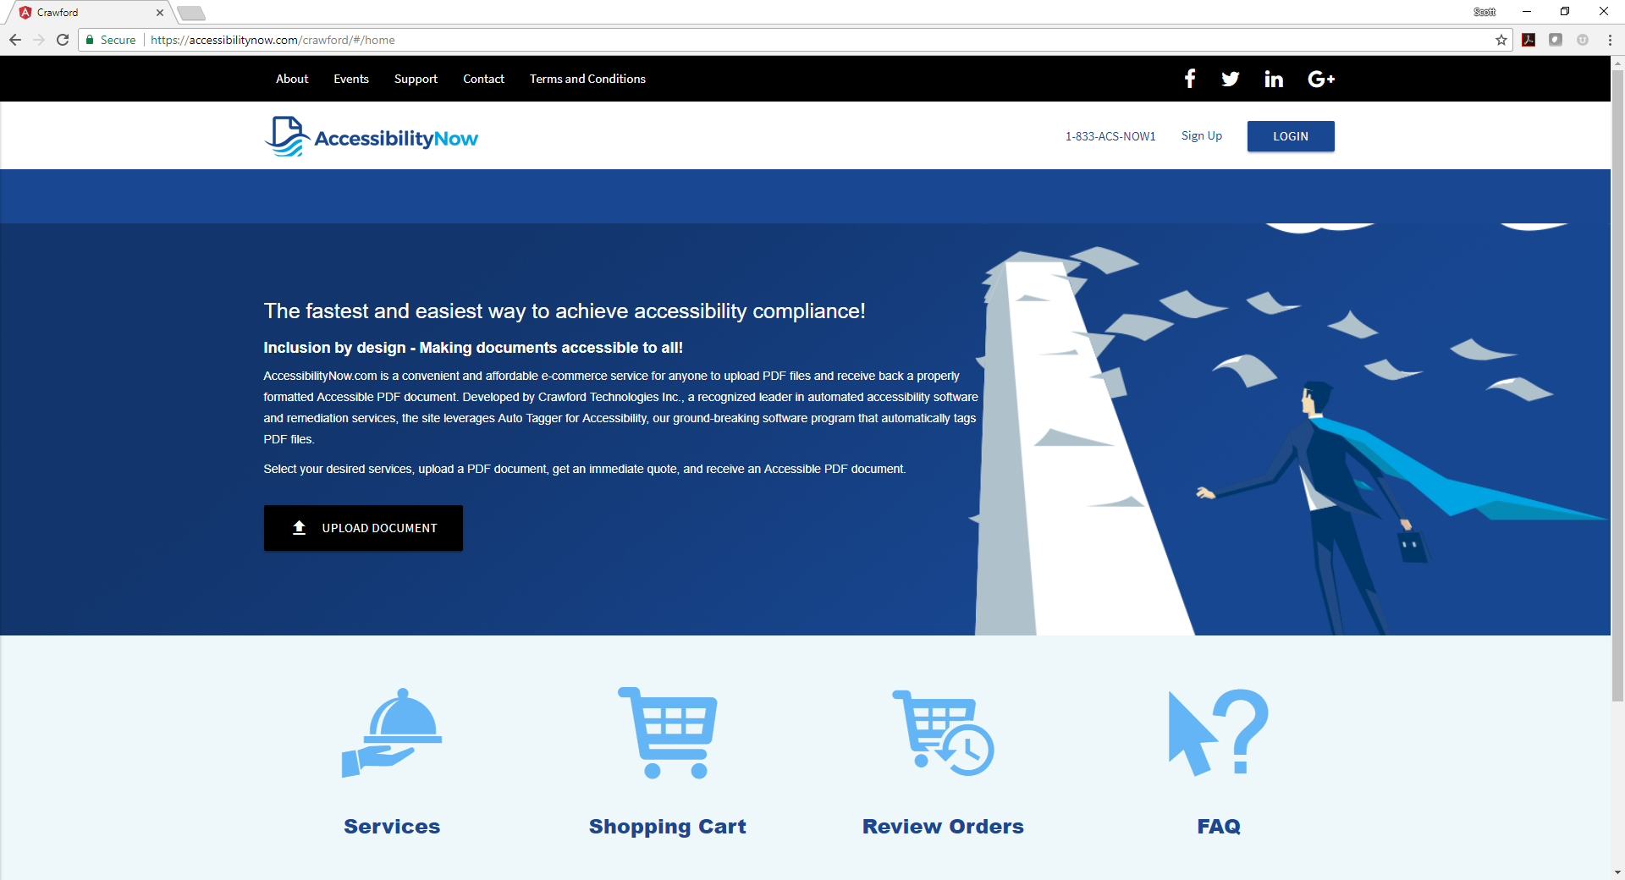
Accessibility Now Website Screen Capture

Slide 9

How It Works
Upload your selected PDF document files
Select your services an receive a quote immediately
Accept the quote and pay via PayPal or credit card
Accessible PDF or Accessible HTML5 files are generated immediately
You receive notification that your remediated files are ready to be downloaded

Slide 10


Remediation for All Via E-commerce
Automated vs. Manual Remediation
Notes:
The choice is a no-brainer

Slide 11
Questions?
Scott Baker
EVP, Business Development
Crawford Technologies Inc
sbaker@crawfordtech.com
+1–603-706-5990

Slide 12

Website Addresses
www.crawfordtech.com
www.accessibilitynow.com
Booth 515

