Slide 1
Accessible PDF vs Accessible HTML: Dispelling the Myths
Presented by
Jen Goulden, EDP, Accessibility Compliance Specialist, Crawford Technologies Inc.
Scott Baker, Executive Vice President, Crawford Technologies Inc.

Slide 2
Your Presenters
Jen Goulden, EDP Accessibility Compliance Specialist, Crawford Technologies Inc.
jgoulden@crawfordtech.com
Scott Baker Executive Vice President sbaker@crawfordtech.com

Slide 3
Today’s Topics
HTML and PDF - are we comparing apples to oranges?
Similarities between accessible HTML and accessible PDF
Demo – comparing HTML and PDF using assistive technology
Differences between accessible HTML and accessible PDF
Myth 1: HTML is “more” accessible than PDF
Myth 2: Accessibility regulations do not apply to HTML
Myth 3: Accessible HTML supports a better user experience than Accessible PDF

Slide 4
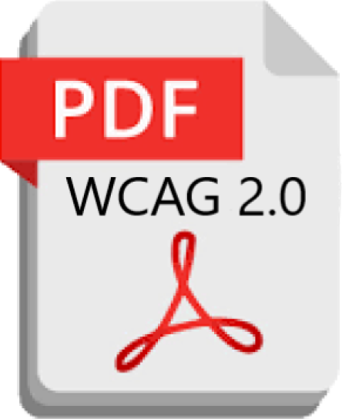
Apples vs. Oranges?
Accessible HTML
Primarily a web format
Inherently accessible
Responsive to mobile devices
Works with any browser
Supports assistive technologies
WCAG 2.0 Level AA
Accessible PDF
Primarily a static document format
Requires remediation
Not responsive to mobile devices
Requires Adobe Acrobat
Supports assistive technologies
WCAG Level 2.0 AA

Slide 5
Similarities
Document hierarchy/tagging structure
Accessible if done correctly, otherwise, not accessible
WCAG compliance
Keyboard commands used for navigation

Slide 6
Differences
Time and skills level involved in file creation
Use on mobile devices
Suitability for use with large document files
Perceptions/biases in the blindness community
Portability

Slide 7
Demonstration

Slide 8
Myth 1
Busted
Myth: HTML is more accessible than PDF
Reality: Accessibility of the output depends on many things
Quality/design of the input file
How the output is generated
When was accessibility considered?

Slide 9
Myth 2
Myth: Document accessibility regulations/WCAG don’t apply to HTML (We still can’t believe people think this!)
Reality: HTML accessibility is covered under WCAG
In fact, HTML is inherently accessible
Semantic HTML
CSS is very useful in navigation
Applies whether the HTML output is a file or a web page
Busted

Slide 10
Myth 3
Myth: Accessible HTML supports a better user experience than Accessible PDF
Reality: Both Accessible PDF and HTML5, if properly coded or designed, can provide an excellent user experience
Screen reader commands used to navigate both formats are the same
Both formats allow the screen reader user to navigate to specific elements including headings, lists and tables
Accessible HTML5 is easier to use on a mobile device, as it is responsive
Navigating accessible PDFs require a PDF reader app such as Adobe Acrobat
Busted

Slide 11
Questions
Thank You!
Jen Goulden, EDP Accessibility Compliance Specialist, Crawford Technologies Inc.
jgoulden@crawfordtech.com
Scott Baker Executive Vice PresidentCrawford Technologies Inc.
sbaker@crawfordtech.com

