Slide 1
Trends in Document Accessibility
Presented by
Ligia Mora, Product Manager, Crawford Technologies Inc.

Slide 2
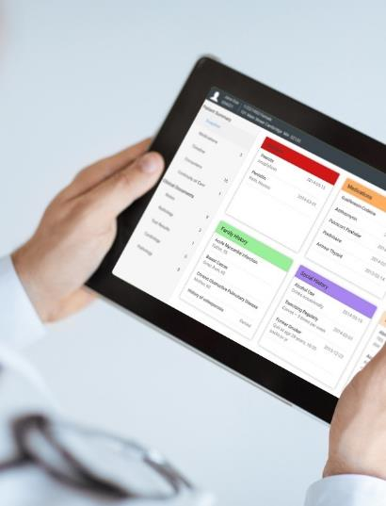
Crawford Technologies
CrawfordTech is a global software company focused on helping enterprises output, digitize and deliver customer communications
Our portfolio and know-how span the intersection of digital output, content management and analytics applications
“The work behind the workflow”
Accessibility
Content Services
Enterprise Output
Software and services provider for accessibility strategies and solutions
Optimizing content distribution strategy and
delivering high-value customer communication archive solutions
Transforming and optimizing workflows for all output processes

Slide 3
Trends Throughout the Times
Some document accessibility
No automation
No preference management
Limited knowledge, costly
Some automation but mostly manual
Limited accessible PDF
No Accessible HTML5
Limited or no preference management
No website accessibility
Automation
Full preference management – Accessible PDF, accessible HTML5, large print, Braille, etc.
Accessible website content
Where does your document accessibility fit?

Slide 4
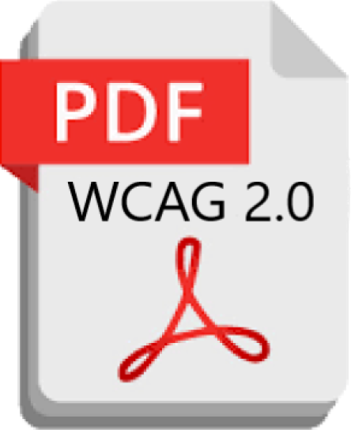
Document Accessibility Workflow
Document remediation
Transactional and Static Documents
Accessible PDF (WCAG, PDF/UA) and HTML5
Braille, Large Print, eText, Audio
Creation and mailing
Website content management
Training
Validation
NOT a one-time event

Slide 5
Common Documents That Must Be Made Accessible
Insurance
Correspondence
Notices
Policies
Plan Summaries
ANOCs
EOBs
Brochures
Renewals
Claims documents
Benefits documents
Annual Reports
HR documents
Government
Government documents
Program descriptions
Service descriptions
Tax bills
School Budgets
Voting instructions and ballots
Correspondence
HR documents
Education
Courseware
Class notes
Enrollment documents
Correspondence
Notices
Transcripts
Scholarships, grants, financial aid documents
Program descriptions
Healthcare
Discharge instructions
Admittance documents
Billing documents
Insurance coverages
Application forms
Benefits documents
Prescriptions and drug information
Financial Services, Banks
Account Enrollment documents
Welcome Kits
Brochures
Loan documents
Statements
Correspondence
Invoices
Investor information
Newsletters
5

Slide 6
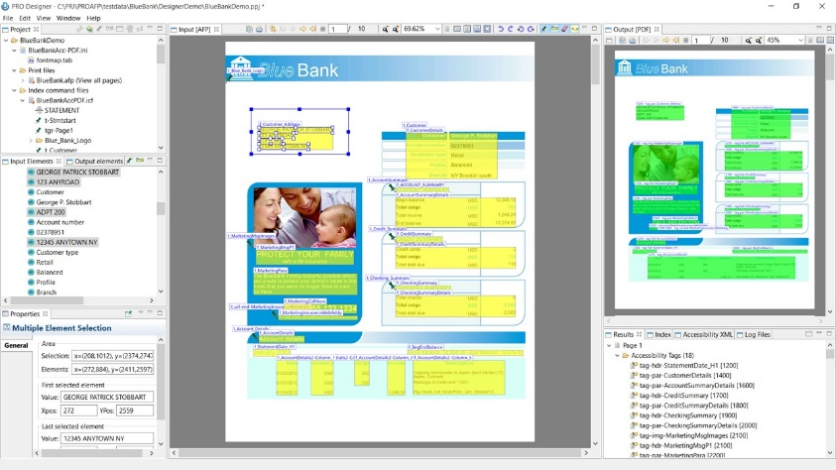
Transactional Data Trends
Template (rules) based tagging
Documents remediation at archive ingestion
Hundreds of pages per second
On-demand or batch processing
Archived documents remediation on-the-fly
Best approach for high volume transactional documents

Slide 7
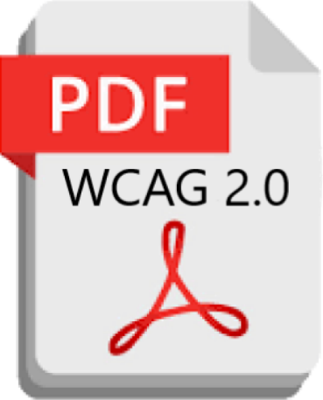
Static Data Trends
Use of AI for automation
Eliminate high percentage of manual remediation/tagging
Some manual quality assurance will be required
Reduce turnaround from days to minutes
Significantly reduce costs for remediation
Or
Files your system generates
AI Auto detection process

Slide 8
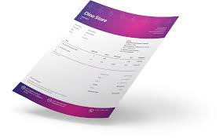
Template Remediation
Input - systematically generated documents in in any printer ready format – remediation at hundreds to thousands of pages per second.
Generally Personal & Confidential

Slide 9
Computer Based Tagging Tools
Easy to implement
Template based
GUI driven
Clear and efficient
Text Content
Fonts
Structure
Tables
Graphics

Slide 10
Problems Leading to the Present Trends
Understanding Accessibility Laws and gaps
Automated desktop based or manual remediation?
Not scalable and requires expertise
Not cost effective
Not secure
No inclusive answer for all scenarios
Lawsuits have timelines

Slide 11
Some Challenges
Making content, educational content, published content, personal and confidential information accessible quickly and easily
Internal document accessibility knowledge
Providing anyone the ability to make content accessible
Training
Automating
QA & QC
Minimum compliance WCAG 2.0 soon to be WCAG 2.1
Once achieved, maintaining compliance

Slide 12
With the Recent String of Legal Activity…
Demand Letters
Lawsuits
“Legal Extortion”

Slide 13
US Regulations
American Disabilities Act (ADA) - Anti-Discrimination Law – Title III
Section 508 RULE for doing business with the US GOV
Federal Employment (501/503)
Federally funded - 504
Affordable Heath Care Act (1557) Health IT
Food and Drug Safety Innovation Act (904)
Telecom Act Section 255
Air Carrier Access Act Airline accessibility DOT rule Title 14 CFR Par 32

Slide 14
Archived and Web Content Documents
Examine Web Content
Automate web contents verification. Find and identify PDFs in need of remediation
Check Document Accessibility
Remediate Content
Make Archived Documents Accessible
Template use for quick and easy remediation
Integrate remediation process with existing workflow
Remediate content on demand
Locate, identifying and remediate PDFs on a website.
Retrieve, remediate and serve up archived documents.

Slide 15
What is the Process for Web Content Remediation?
First step towards online accessibility compliance
Use an automated and thorough web crawler tool
Find all PDF documents
Examine each PDF for accessibility level
Once complete, Setup a plan to maintain accessibility compliance

Slide 16
Tools and Technology
Application technology for easy access
Computer based tagging tools
Automated remediation
Template methodology
Understanding of PDF / document “guts”
Font exposure
Document structure and positioning
Understanding Print Description Languages

Slide 17
Why is Website Content Remediation Important?
Document accessibility lawsuits are increasing rapidly
Real threat with huge fines and fees, settlements in the millions
Uncharted territory for many organizations
Difficult to correctly identify every document on a website
Once identified, remediation process can be timely and inaccurate
Bottom line, an efficient web crawler and validation tool can save you lots of time and money

Slide 18
Accommodations & Physical Formats
Beyond digital websites, ADA Title III requires reasonable accommodation
Large Print
Braille (Contracted and Alphabetic)
Audio
Other Accessible formats
Get familiarized in order to understand that these requests must be accommodated

Slide 19
Aspects of a Good Remediation Tool
GUI Remediation tool
Easy to use, GUI based remediation and quality assurance tool
Automatically senses document elements
Provides user friendly tool for completing remediation
Reduces turnaround from hours to minutes
Significantly reduces costs for remediation

Slide 20
Complete Document Accessibility Platform
Transactional
Published/Static

Slide 21
Questions
Thank You!!!
Ligia Mora
Product Manager
Crawford Technologies Inc.

