Slide 1
How Tax Authority Remediates Their Microsoft Word Documents to Ensure Compliance
December 17, 2020
1

Slide 2
Meet us
Katrina Fox
Marketing Specialist
Crawford Technologies Inc.
Harel Cohen
Internet & New Media Manager
Israel Tax Authority
Shirley
Cohen - Schwartz
Co-Founder and CEO
WeCo Solutions Ltd.
Ligia Mora
Business Development Manager, Crawford Technologies Inc.
2
Notes:
Katrina

Slide 3
Agenda
Introductions and Background
Document Accessibility Overview
WeCo Solution Overview
Case Study – The Israeli tax authority
Word Document Remediation Challenges
Implementation of WeCo
Notes:
Ligia

Slide 4
About Tax Authority
Tax Authority
Approximately 6500 employees
Potentially 700 employees are Word documents remediators
Various departments that publish information. The economy unit, the value added Tax unit, The income tax unit, The accounting audit unit, customer service unit, the press secretary, customs headquarter etc.
Various levels of experience with Word
Little to no experience in document accessibility
Public documents to be shared via web
4
Notes:
Ligia delivers. IRS, Customs, Property Taxes, etc. At end of slide: Harel, Can you give us some details about your experience and interest with document accessibility and also give a little background on Tax Authority.

Slide 5
About WeCo
WeCo Solutions
Providing document accessibility and Word Remediation solutions.
Mainly work with public sector, academy institutions and finance sector.
WeCo’s vision is to make documents accessible for all and by all.
IAAP Certified Professionals
Members of the PDF Association
5
Notes:
Ligia delivers. At end of slide: Shirley, could you talk about what made you so successful not just in the Tax authorities but also in other organizations that have installed and worked with WeCo?

Slide 6
Why is Document Accessibility Important?
Vision problems are more pervasive than most of us realize. Upwards of 1.3 billion people worldwide are visually impaired. Many more have low or moderate visual difficulties.
Up to 66 million people in the US have vision impairment
Even with corrective lenses, they still have trouble seeing
Source: A Hidden Market: The Purchasing Power of Working-Age Adults With Disabilities APRIL 2018
Authors of the study: Michelle Yin, Dahlia Shaewitz, Cynthia Overton, and Deeza-Mae Smith
Source: World Health Organization October 2019.
6
Notes:
Ligia

Slide 7
Accessibility Document Structure
Title
Headers
Lists
Tables
Alternate Text
Hyperlinks
Color Contrast
Etc.
7
Notes:
Ligia

Slide 8
WeCo Word Remediation
Best in breed “In-House Accessibility” Software Solution.
No prior knowledge or advanced skills are required.
Standardization - Organizational Accessibility Policy.
Fastest ROI
Wizard Driven
Fast & Efficient remediation process:
Content Creation
Accessibility Remediation
Accessibility Validation
Content Publication
An organization's employees produce content normally
WeCo Solutions guides employees through the remediation process using built in, walk through, wizard, combined with guidelines and automation
WeCo’s built-in Accessibility validation tool ensure the document accessibility level meets the requirements
Accessible documents Word/PDF can be uploaded to Websites and/or be sent via Email
Notes:
Shirley

Slide 9
AccessibilityNow ® WeCo Overview
Microsoft Word users can create accessible documents easily
Walkthrough of accessibility process
Extended functionality
Proactive approach
Plugin to Microsoft Word
Creates accessible Word and PDF
"Step by step" accessibility wizard
Automation of most accessibility activities
Easy to use – designed for everyone
9
Notes:
Shirley

Slide 10
Word Document Remediation Challenges
Huge number of documents annually
Lack of knowledge at the authoring level
Complicated and Time Consuming
Who is responsible for document accessibility?
Planning, managing and enforcing internally
Website management becomes bottleneck
How to create an organizational standard?
Costly
Microsoft
Word
Proficiency
Time
Allocation
Web
Accessibility Guidelines
10
Notes:
Ligia – Mention Word level knowledge, nothing to experts & also mention people trained then leave

Slide 11
What lead Tax Authority to WeCo
Prior solutions
Upgrade to Newer version of Microsoft Office with Accessibility features
PDF Remediation solutions
Acrobat PRO DC
Remediating at the Word level
11
Notes:
Ligia: Harel, what kind of struggles did you encounter prior to WeCo?
Can you tell us about the process, what was tried and why didn’t it work?
Prior to WeCo, how much time did you invest in trying to train people in Word remediation?

Slide 12
Why does WeCo Remediate at the Word level?
Document writers know their document structure, layout and context
Easier to fix accessibility issues at the source file
Inclusivity by design
12
Notes:
Ligia

Slide 13
Why AccessibiltyNow® WeCo?
Word plug-in
Walk Through Tagging Process
Organizational Document Accessibility Policy Enforcement - Regardless of user's skills.
Ability to Use & Publish documents immediately after creation.
Quick to implement
Inclusivity by design
13
Notes:
Ligia. At end, ask: Harel, could you please explain the process for rolling out WeCo enterprise wide. How long did it take to train everyone, to install, test, etc.

Slide 14
Benefits
Same Platform Microsoft Word
Easy to understand and easy to use
Resolved problems with which people were struggling
Provides Standardization for Visualization
14
Notes:
Ligia will ask Harel to talk about the benefits of using WeCo

Slide 15
More Benefits
Saves time and Money
Step by Step Wizard
Additional Word Functionality
Plug and Play – simple and intuitive
15
Notes:
Harel

Slide 16
Easy Tool Bar
16
Notes:
Ligia will ask Shirley to talk about the Easy-to-use Tool bar

Slide 17
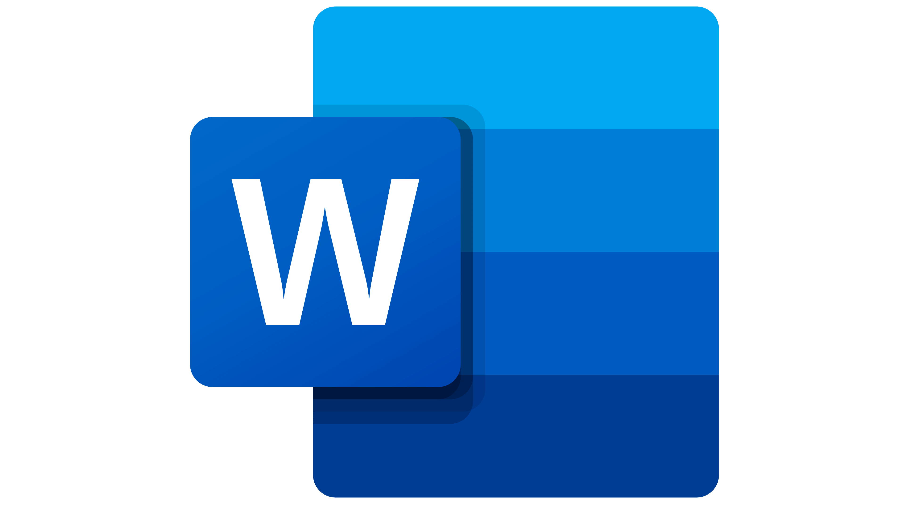
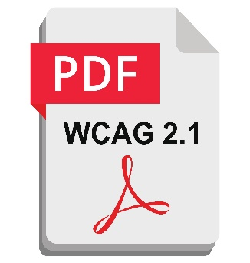
WeCo Word Accessibility – Step by step
1
2
3
4
Settings
Headings
Tables
Others
Metadata
Visual Appearance
Hierarchy
Identify Type
Images
Hyperlinks
Color Contrast
Accessible
17

Slide 18
Step by Step Wizard
18
Notes:
Ligia will ask Shirley to talk about the Wizard

Slide 19
Aspects of a Good Remediation Tool
Easy to use, GUI based remediation and quality assurance tool
Automatically senses document elements
Provides user friendly tool for completing remediation
Reduces turnaround from hours to minutes
Significantly reduces costs for remediation
19
Notes:
Ligia

Slide 20
WeCo Advantages - Organizational benefits:
Saves training ,support and maintenance time
Centralized organizational policy and Standard design
Workflow and controlled process
In house remediation with Microsoft Word
Saves money
20
Notes:
In conclusion, Harel and Shirley, could I ask you to sum up the advantages of the WeCo solution.

Slide 21
WeCo Advantages - Employees benefits:
Work with Word! The document authors editing tool
Saves remediation working time
Easy, simple wizard
Predefined centralized design
No need for pre-knowledge in
word functionality
Accessibility guidelines
Document creation independence
21

Slide 22
Questions?
Find us on Facebook, LinkedIn and Twitter Visit: crawfordtech.com e-mail: lmora@crawfordtech.com
Phone: +1.619.871.9253
22

